Slide 1
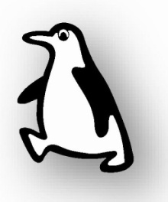


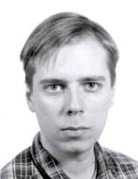

Coherence from vacuum fluctuation
Summary:
much ado about nothing
classical parametric excitation
dynamical Casimir effect
photon generation with a Josephson metamaterial
- samples and experimental setup
- spectrum of noise
- two-mode squeezing
tripartite correlations from vacuum fluctuations
conclusions and prospects
Pasi Lähteenmäki,
Sorin Paraoanu,
Juha Hassel, and
Pertti Hakonen
Cryocourse 2016: School and Workshop in Cryogenics and Quantum Engineering,
25.09.2016 – 03.10.2016
Low Temperature Laboratory,
Department of Applied Physics,
School of Science, Aalto University
and
State Research Center of Finland (VTT)

Slide 2
Much ado about nothing
G. S. Paraoanu,The quantum vacuum, arXiv:1402.1087

Slide 3
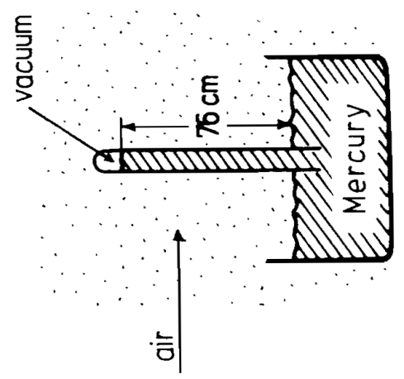
Aristotle (Physics, book IV) –
in vacuum motion would continue ad infinutum
Toricellian vacuum
(Evangelista Toricelli, 1643)
First vacuum pump, Magdeburg hemispheres
experiment (Otto von Guericke, 1654)
... Modern view of vacuum = quantum-mechanical ground state of
a field e.g. Dirac vacuum, BEC vacuum, Higgs vacuum etc.
Effects related to vacuum: spontaneous emission,
static Casimir effect, Lamb shift, renormalization of charges,
cosmological constant ...
How to get something out of vacuum:
use strong electric fields [Schwinger effect]
change fast a boundary condition or the speed of light
(dynamical Casimir effect) this talk mostly ...
use a strong gravitational field [Hawking effect]
accelerate the system [Unruh effect]

Slide 4
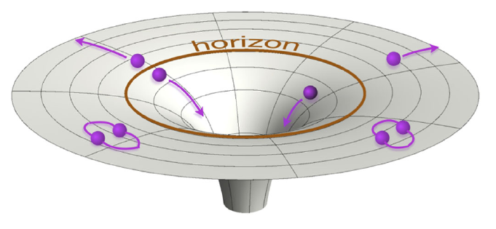
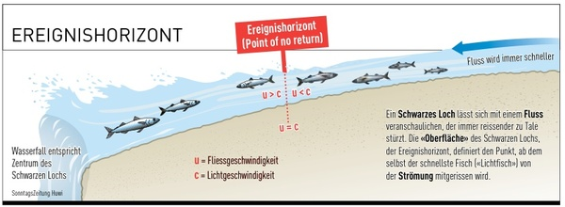
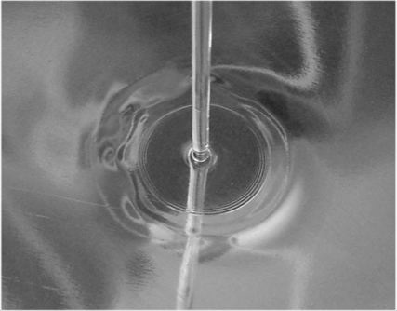
Gravitational effects
and its analogs
TheHawking effect
Estimate:
For a black hole with M = the solar mass
... but the c.m.b. is at 2.7 K
If then one gets a Hawking temperature of 100mK
Analogs - a black hole in your bathtub

Slide 5
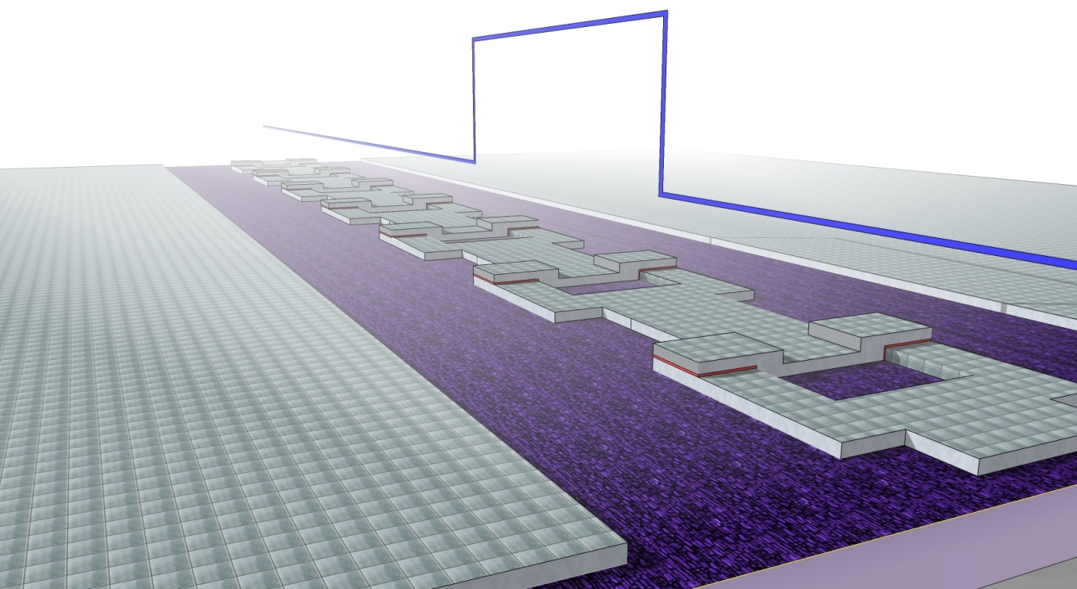
Analog cosmological effects in SQUID arrays
Hawking radiation
connection between thermodynamics and quantum physics in curved space-time
predicted for black holes BUT cannot be detected in astrophysical measurements
believed to be a cornerstone result that any theory of quantum gravity must account for
Schützhold, R., and W. G. Unruh, 2005, ‘‘Hawking Radiation in an Electromagnetic Waveguide? Phys. Rev. Lett. 95, 031301
Nation, P. D., M. P. Blencowe, A. J. Rimberg, and E. Buks, 2009, ‘‘Analogue Hawking Radiation in a dc-SQUID Array Transmission Line,’’
Phys. Rev. Lett. 103, 087004

Slide 6
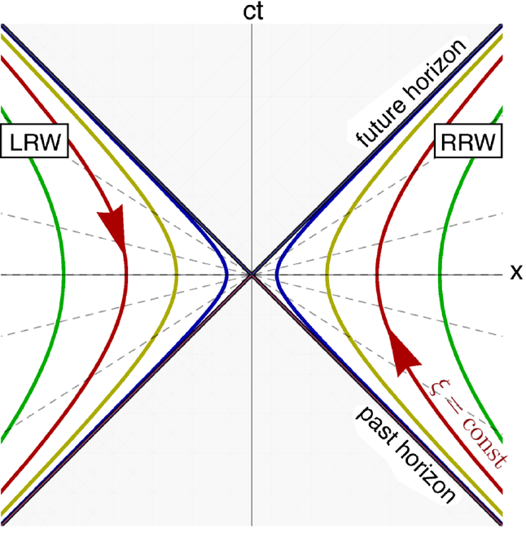
The vacuum and
the equivalence principle
TheUnruh effect
Estimate:
Andromeda = 2.5 milion light-years away
Proxima Centauri = 4.24 light-years away

Slide 7
Parametric excitation

Slide 8
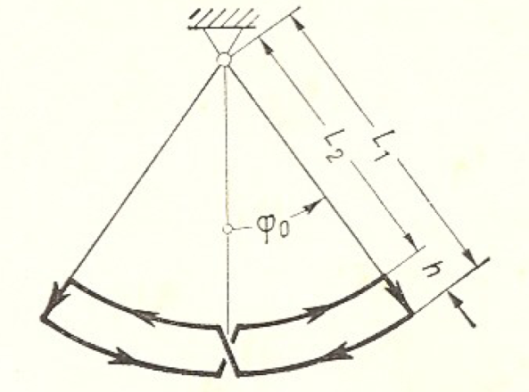

Parametric processes
First observation: rough waves on liquids
(wine in a ”singing” glass)
Faraday, M. (1831) "On a peculiar class of acoustical figures; and on certain forms assumed by a group of particles upon vibrating elastic surfaces", Philosophical Transactions of the Royal Society (London), vol. 121, pages 299-318.
Pump the system at twice its natural
oscillation frequency:
Parametric oscillation can be:
innocuous: e.g. child in a swing
useful: e.g. low-noise parametric amplifiers
dangerous: e.g. bridges, container ships
Parametric rolling of a cruise ship
(lateral waves hit the vessel every half the natural rolling period):

Slide 9
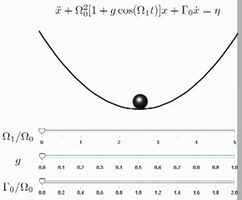
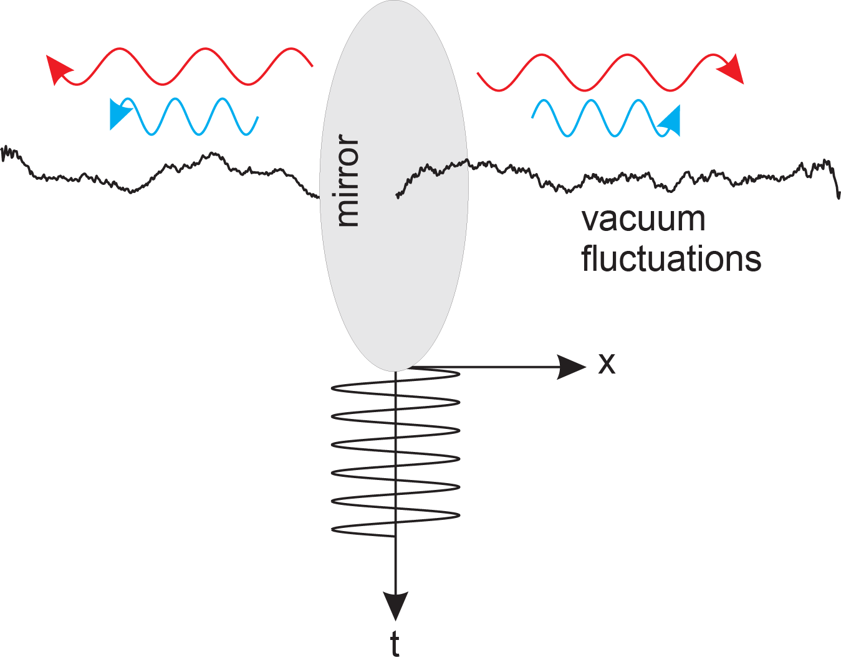
Classical versus quantum parametric excitation
(Mathieu equation)
Needs some nonzero initial
conditions (either speed or position)
in order to produce an effect.
Therefore the classical vacuum
cannot be parametrically excited.
But the quantum vacuum has inherent zero-point motion fluctuations, therefore it can be parametrically excited.

Slide 10
Dynamical Casimir effect
P. Lähteenmäki, G. S. Paraoanu, J. Hassel, and P. J. Hakonen,
Dynamical Casimir effect in a Josephson metamaterial,
PNAS 110, 4234 (2013)

Slide 11
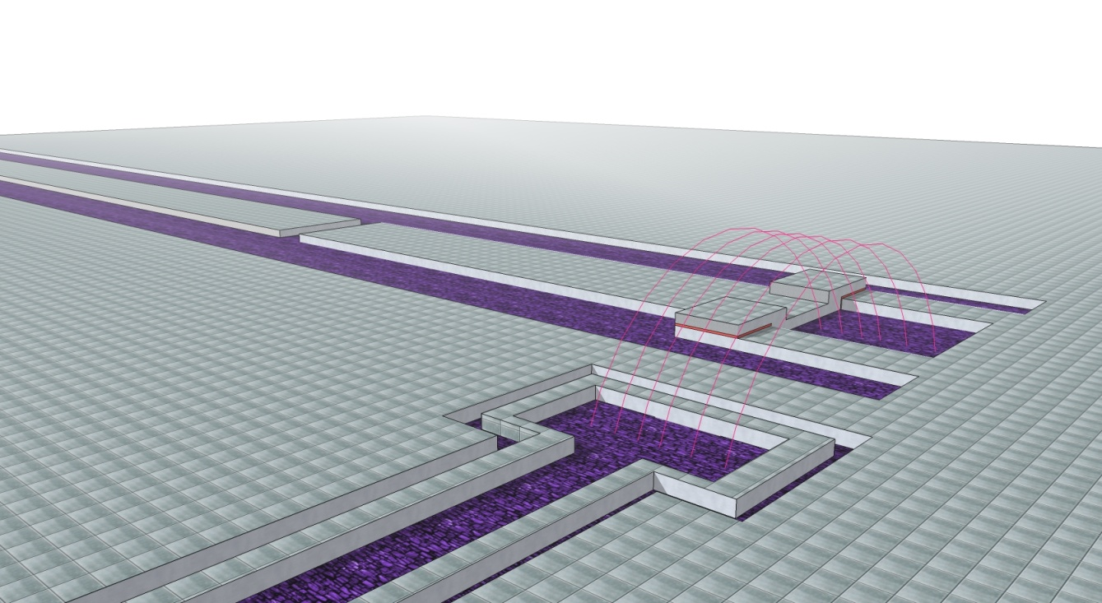
Dynamical Casimir effect
predicted many years ago but never observed until recently
superconducting resonators offer perhaps the most promising system
Moore, G. T., 1970, ‘‘Quantum theory of the electromagnetic field in a variable-length one-dimensional cavity,’’ J. Math. Phys. (N.Y.) 11, 2679.
Johansson, J. R., G. Johansson, C. M. Wilson, and F. Nori, 2009, ‘‘Dynamical Casimir effect in a superconducting coplanar waveguide,’’Phys. Rev. Lett. 103, 147003
Wilson, C. M., G. Johansson, A. Pourkabirian, M. Simonen, J. R. Johansson, T. Duty, F. Nori, and P. Delsing, 2011, ‘‘Observation of the Dynamical Casimir Effect in a Superconducting Circuit,’’ Nature (London), 479, 376

Slide 12
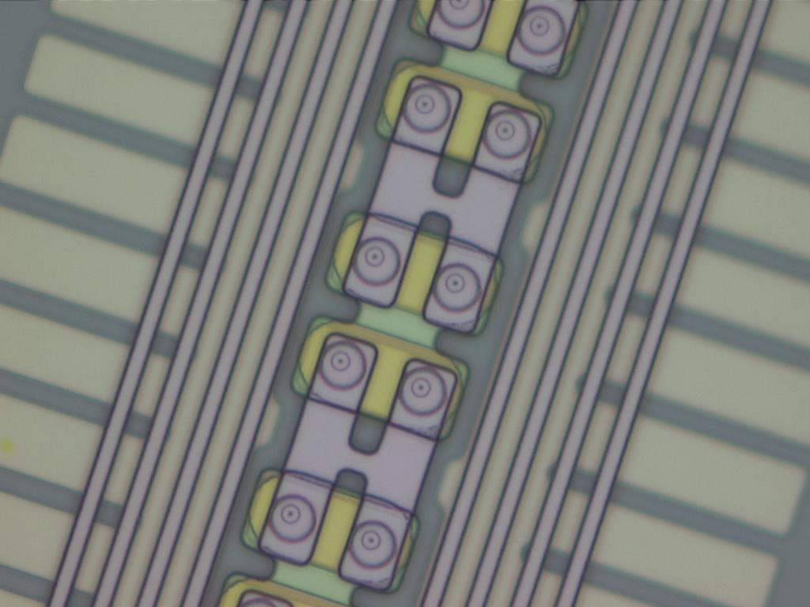
Josephson metamaterials

Slide 13
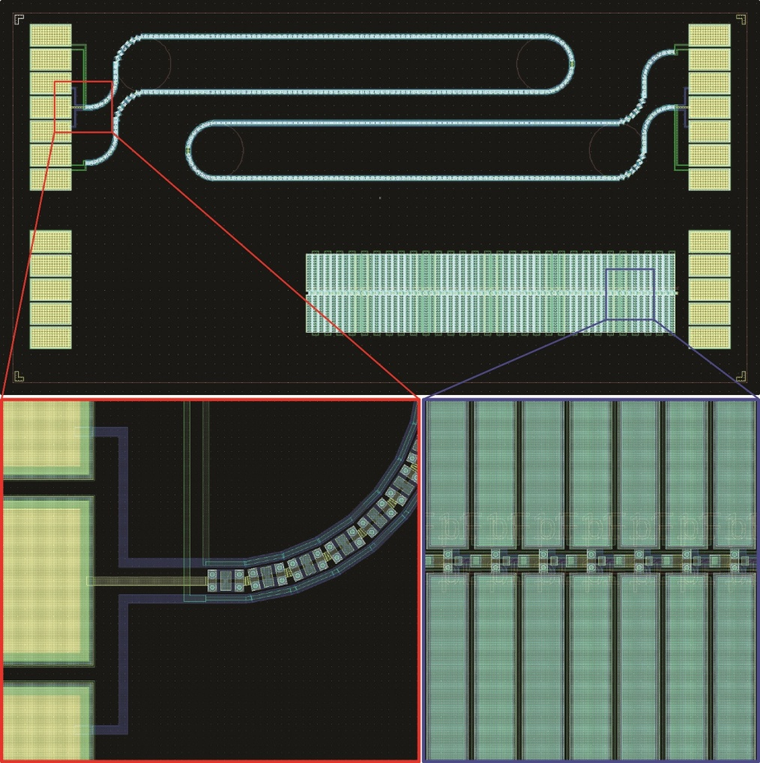
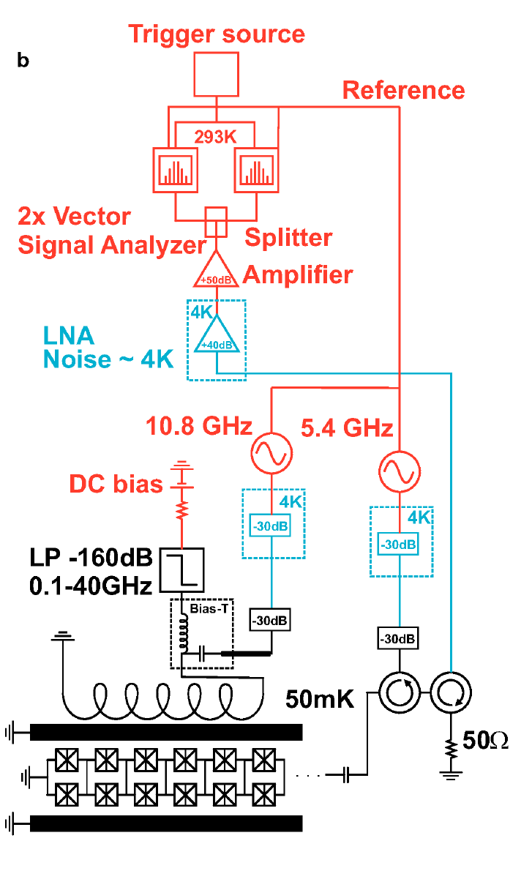

Slide 14
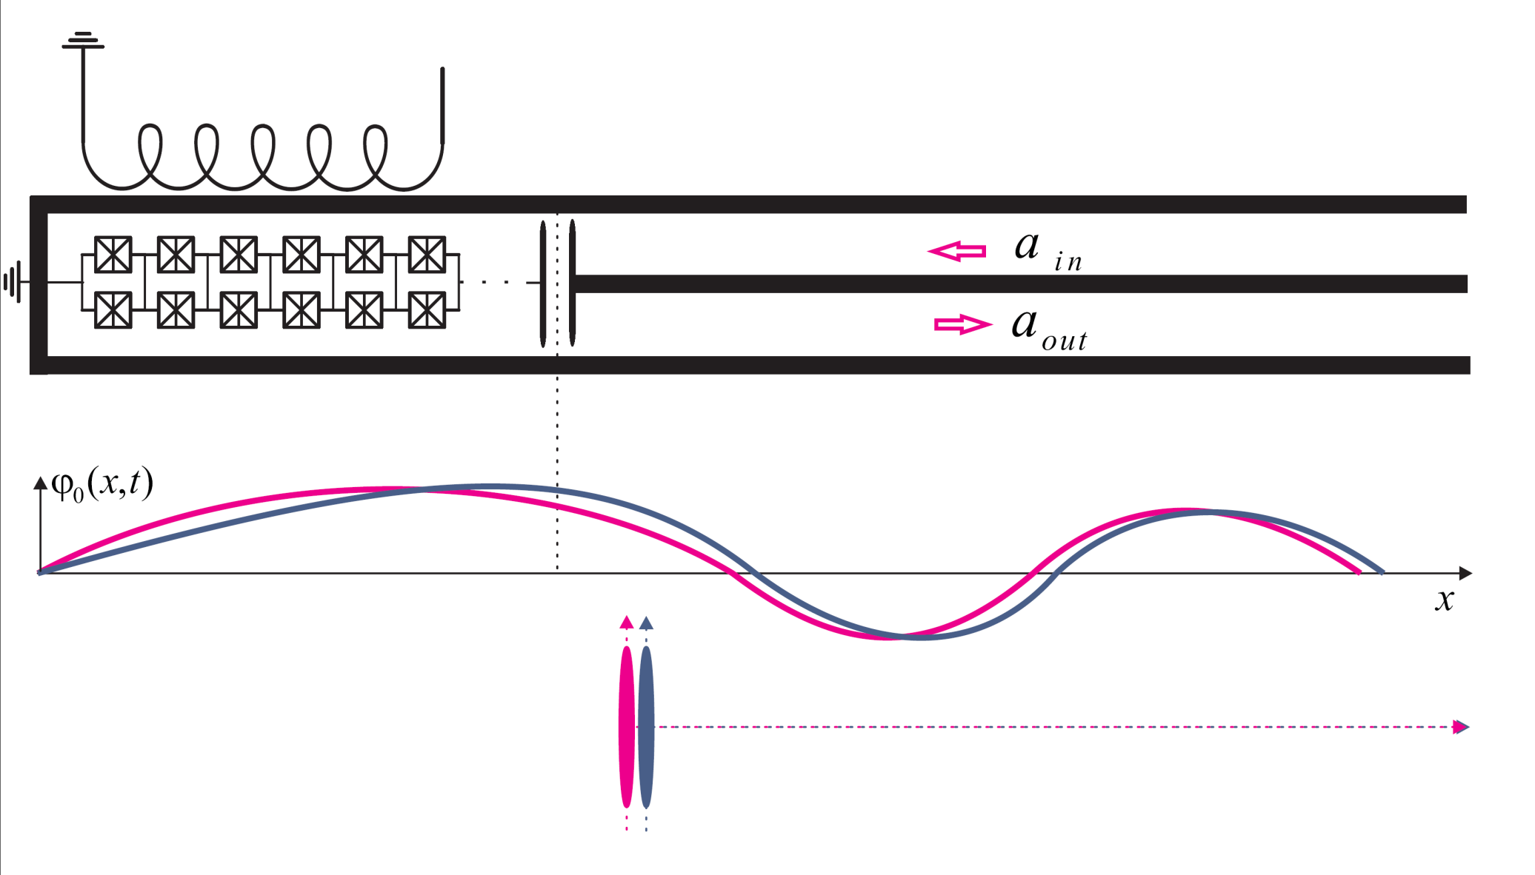
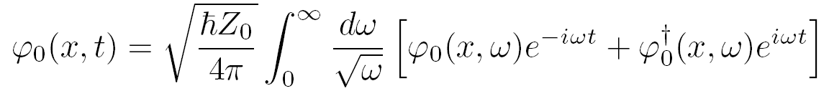

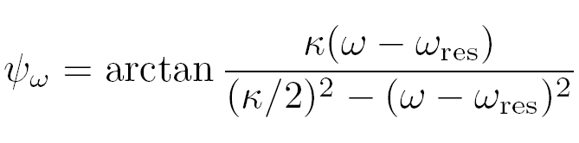


Slide 15
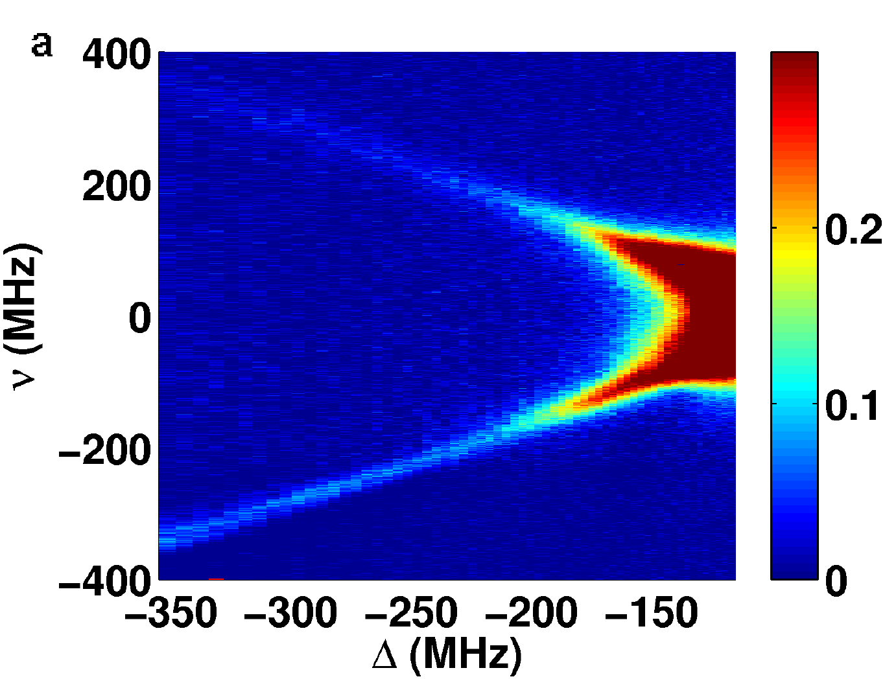
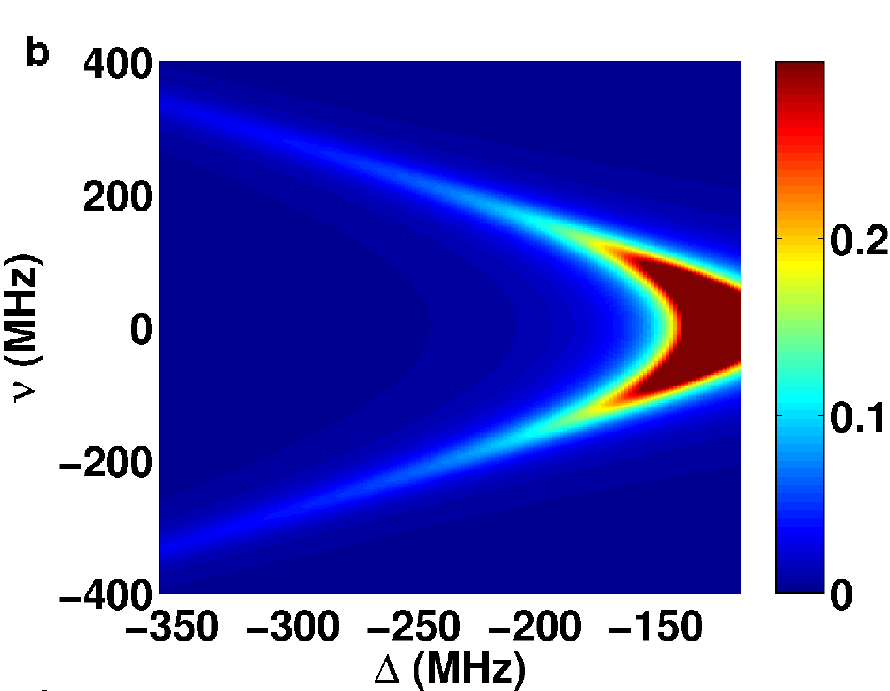
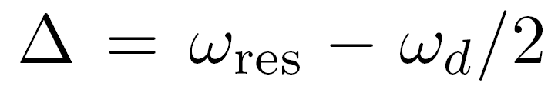
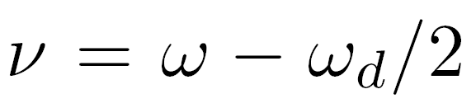
Measurements at large detunigs
Direct experimental evidence of frequency upconversion of vacuum fluctuations

Slide 16
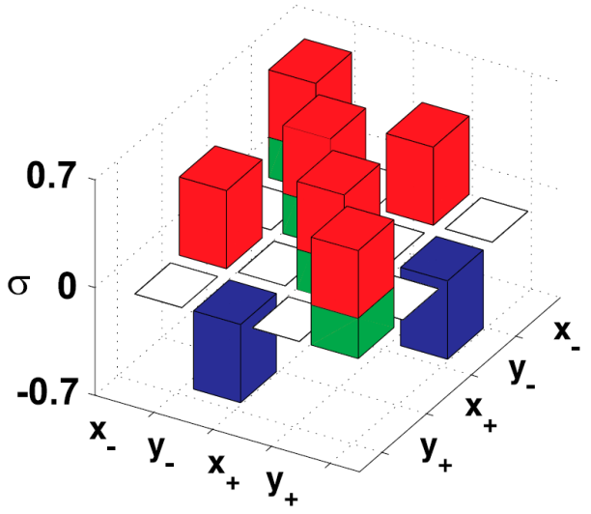
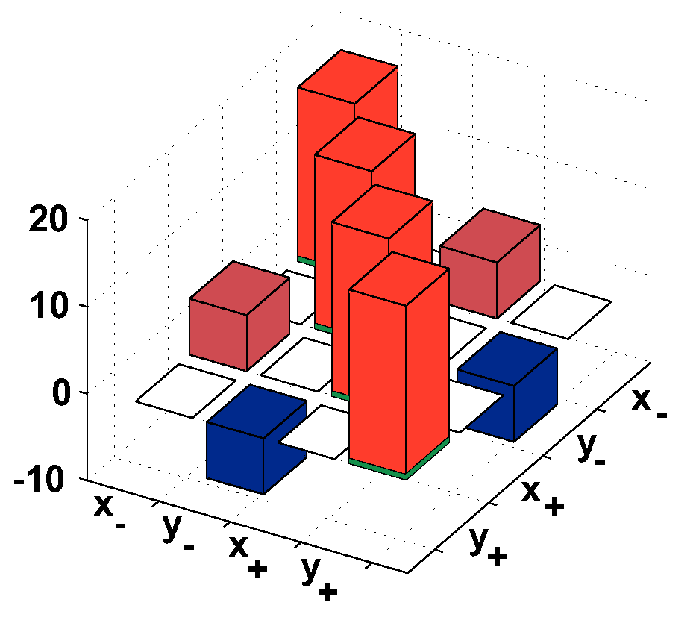
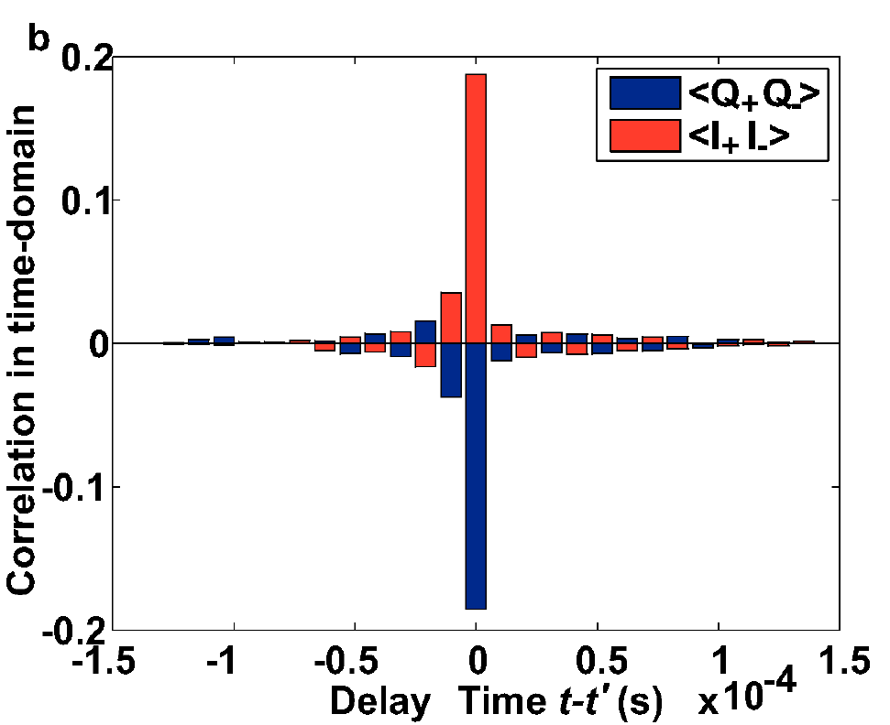
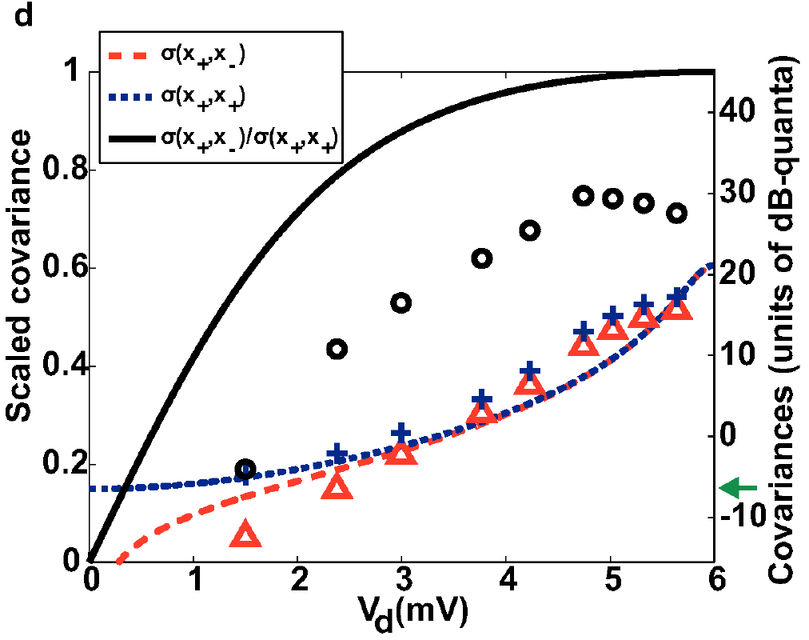
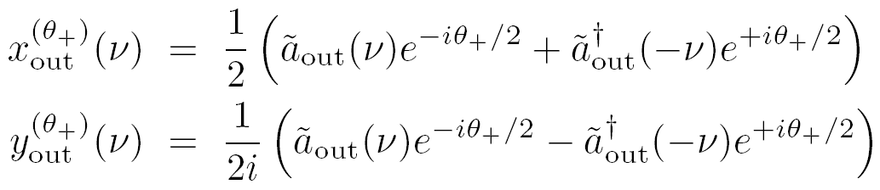
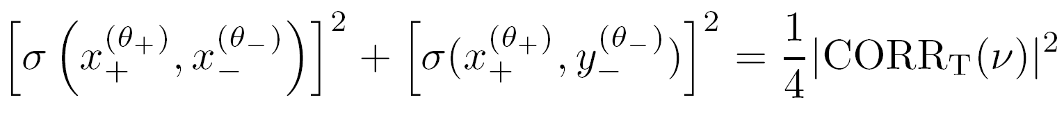



Measurements of quadrature correlations
Pithagora’s theorem for covariances:
Nonseparability:
C. Eichler,D. Bozyigit, C. Lang, L. Steffen, J. Fink,
and A. Wallraff, Phys. Rev. Lett. 107,113601 (2011)

Slide 17
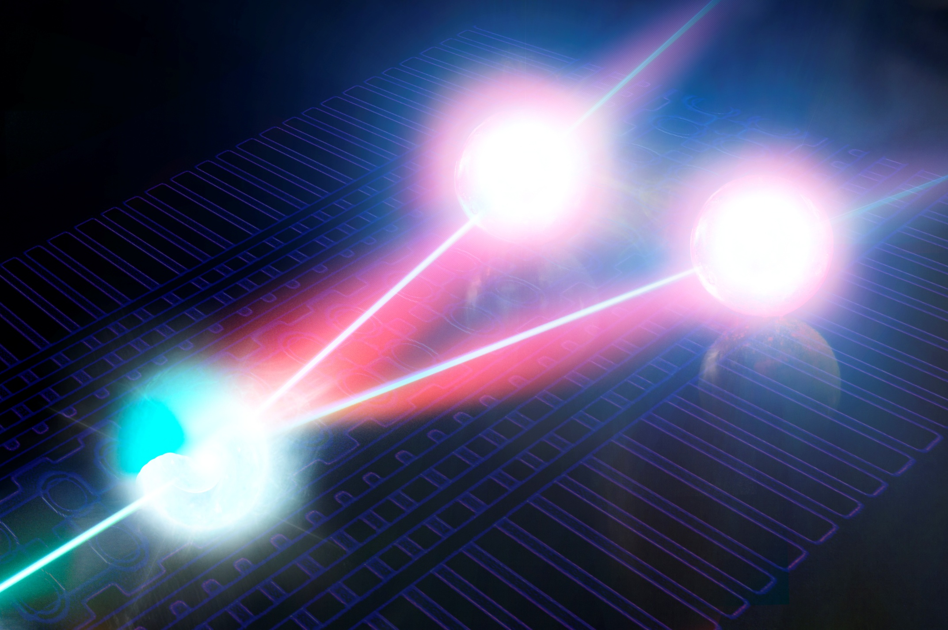

Slide 18
Tripartite correlations
from vacuum fluctuations
P. Lähteenmäki, G. S. Paraoanu, J. Hassel, and P. J. Hakonen,
Coherence and multimode correlations from vacuum fluctuations
in a microwave superconducting cavity,
Nature Communications 110, 12548 (2016)

Slide 19
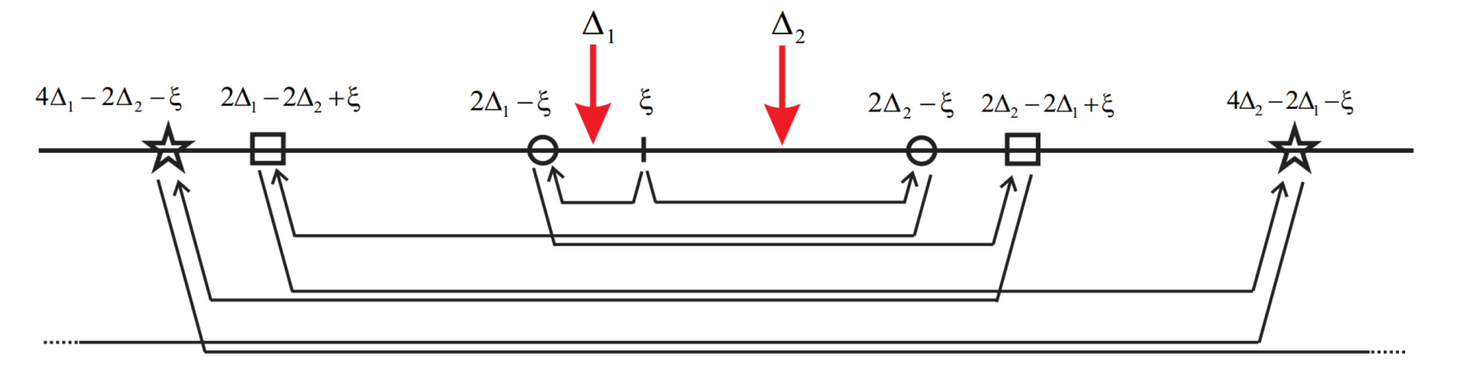
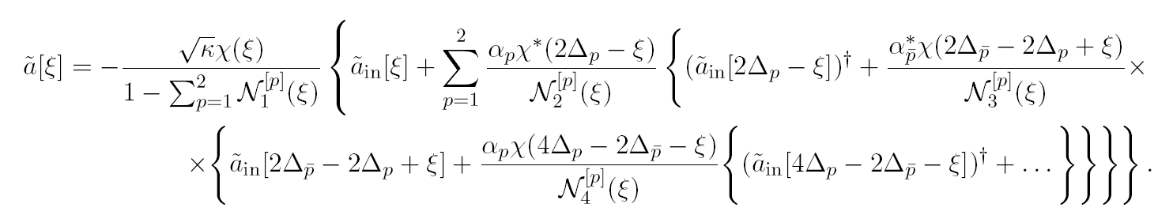


Slide 20
Coherence and multimode correlations from
vacuum fluctuations

Slide 21
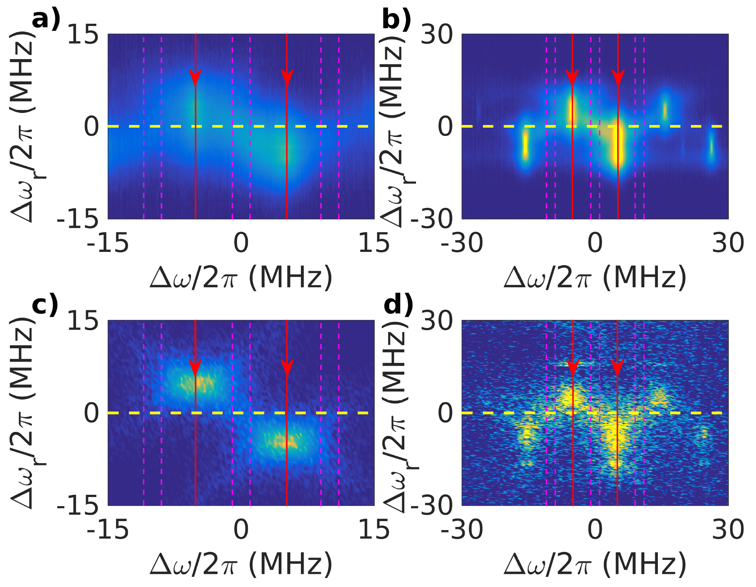

Slide 22
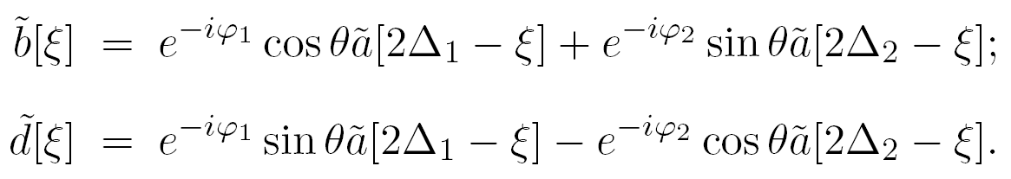
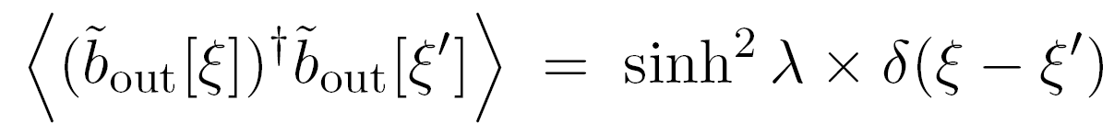
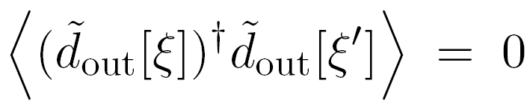
Coherence between
extremal modes:
notations for power:
coherences:
bright and dark modes:

Slide 23
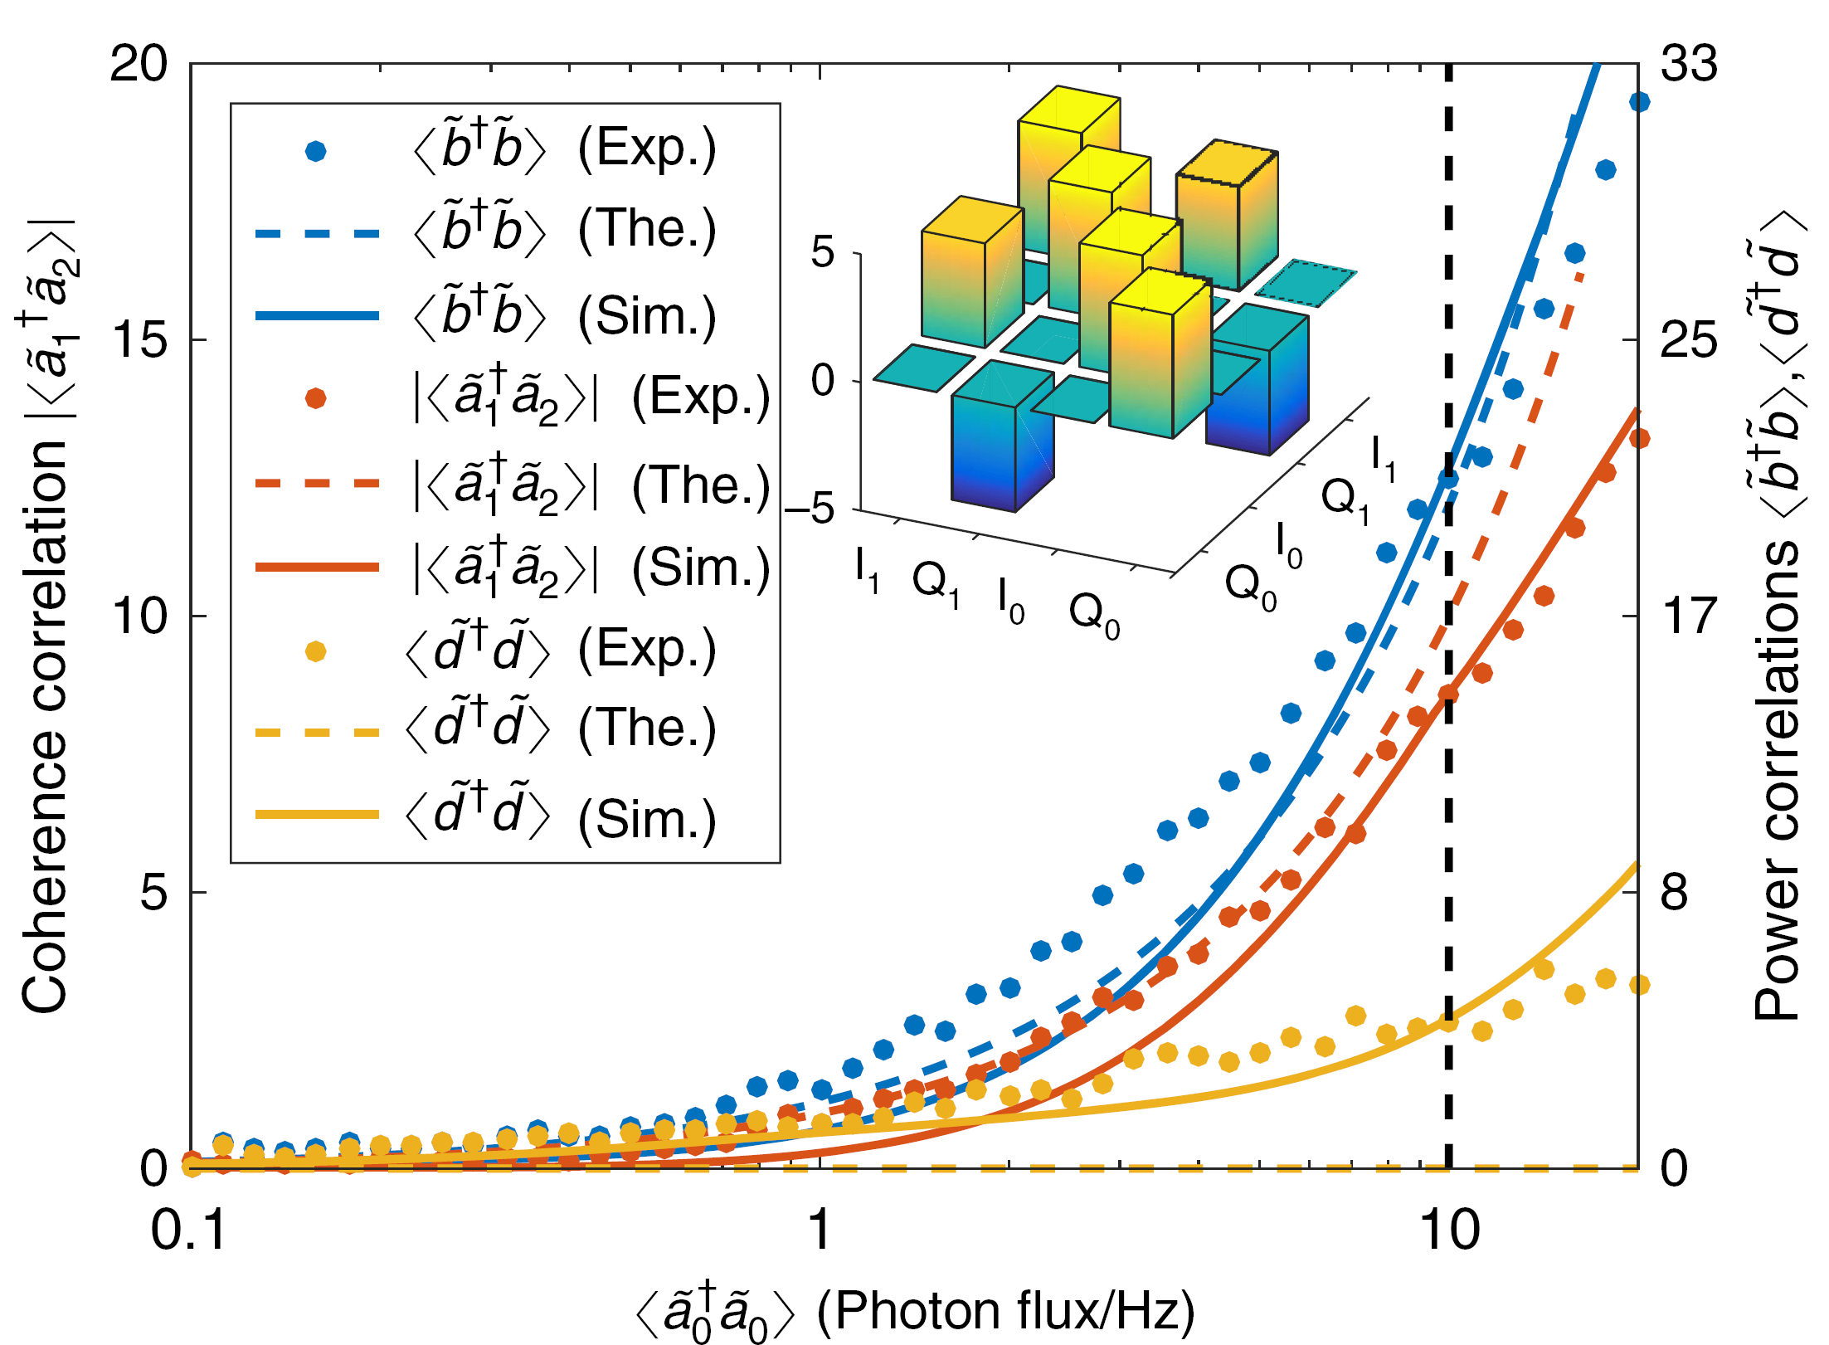

Slide 24
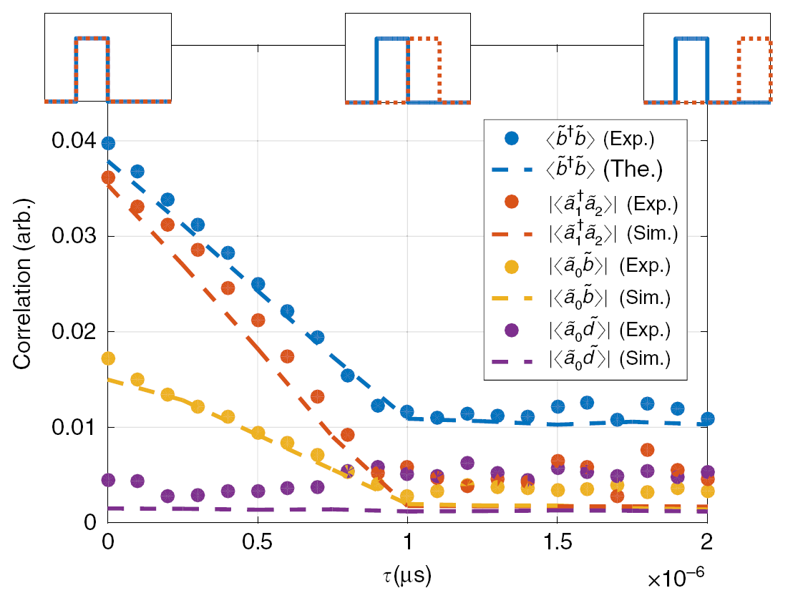
Dynamical control of correlations

Slide 25
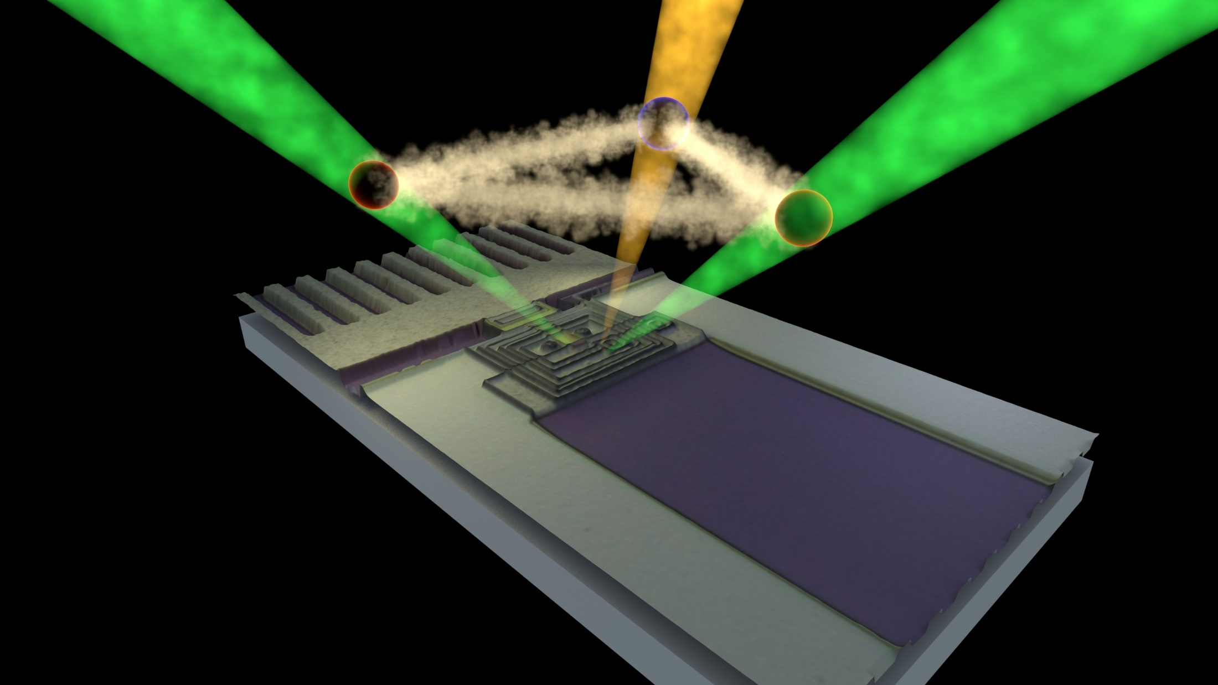

Slide 26
Conclusions and prospects

Slide 27
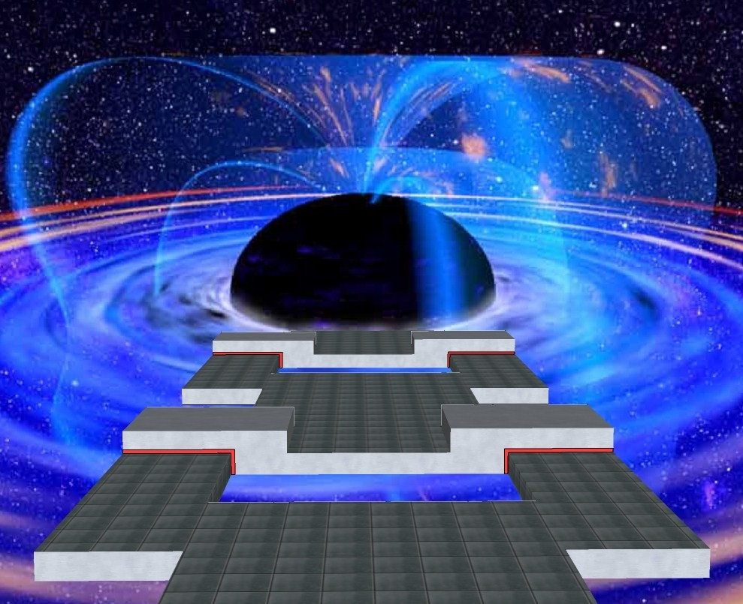

Slide 28
We did:
experiments simulating the Klein-Gordon field with SQUID arrays embedded in a cavity and with a transmission line terminated by a resonator -
dynamical Casimir effect –
tripartite photonic states
Future developments:
realization of other cosmological effects: Hawking radiation, Unruh effect
single-quanta control of macroscopic properties in quantum metamaterials
metamaterials with tunable photonic gap (photonic crystals)

Slide 29
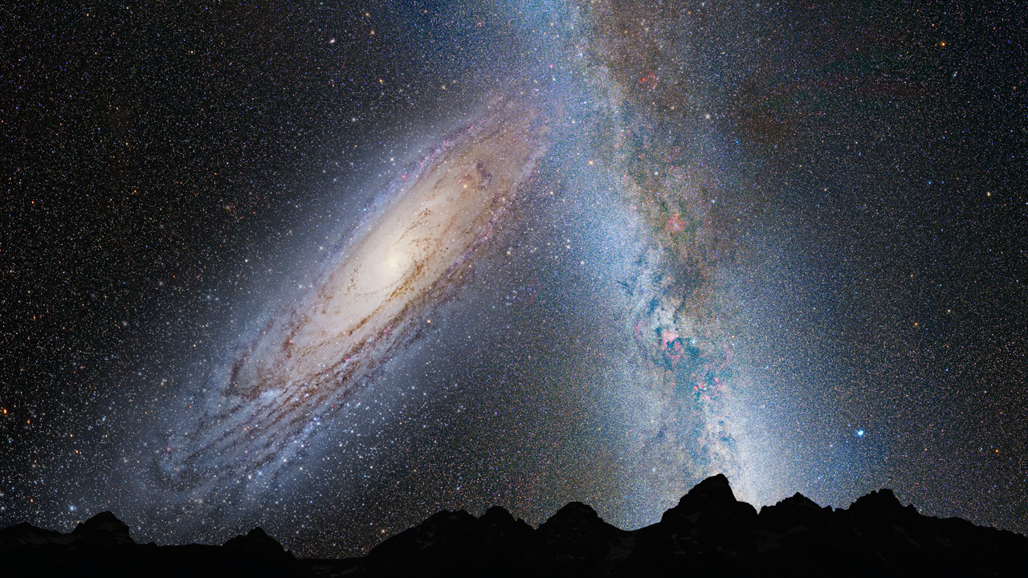
... re-creating the Universe in the lab ...

Slide 30
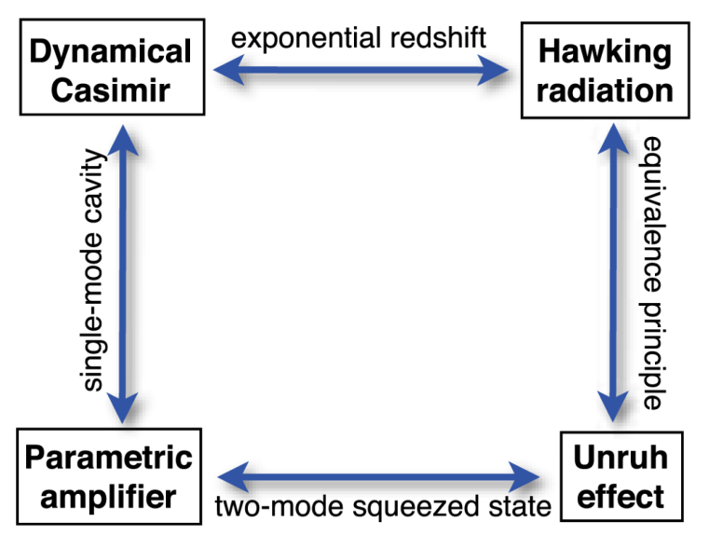
E Pluribus Unum
Suppose we have two modes a and b and we want to combine them coherently.
Mathematically, there are only two possibilities:
1. Called beam-splitter transformation.
Noncommutativity of c results in therefore a natural parametrization is
and
Main application: interferometry.
Called Bogoliubov (or squeezing) tranformation.
Noncommutativity of c results in therefore a natural parametrization is
and
Main application: amplification.
P.D. Nation, J. R. Johansson, M. P. Blencowe,
and Franco Nori, Rev. Mod. Phys. 84, 0034 (2012)

