Slide 1
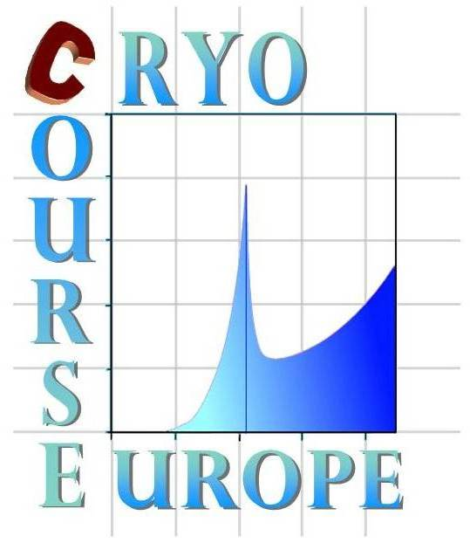



Cryocourse 2016:
School and Workshop in
Cryogenics and Quantum Engineering
26th September to 3rd October 2016
Aalto University, Espoo, Finland
Dilution refrigerators
Part II: design and operation
Henri GODFRIN
CNRS/IN/MCBT – Grenoble

Slide 2
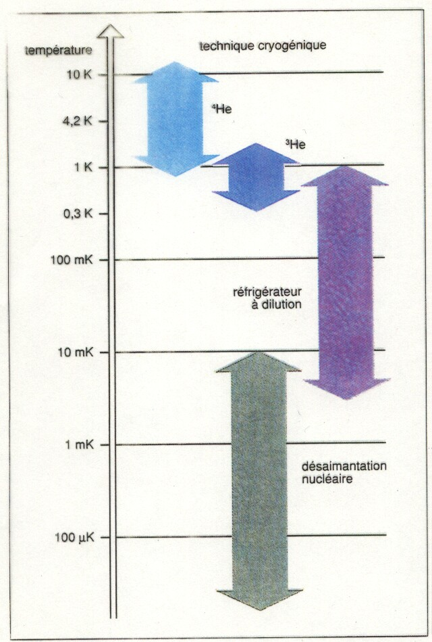
Refrigeration:
Temperature range

Slide 3
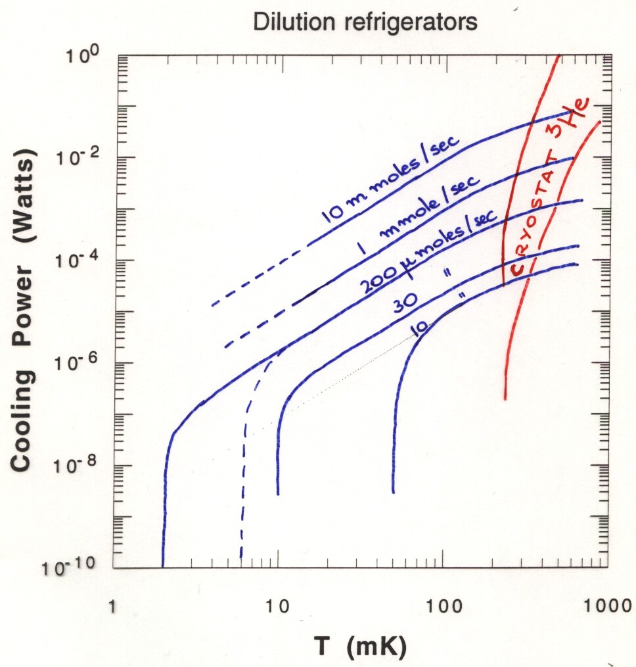
Cooling power

Slide 4
General considerations
Dilution Refrigerators
- Minimum temperature T= 2 mK in CONTINUOUS operation.
Cooling power = 82 dn/dt T², for T>3 T_{min}
Sophisticated machines! Do you really want to have a DR???
Use a ³He cryostat if you do NOT need temperatures below 0.3 K!
- Advantages of a ³He cryostat :
  Higher cooling power
  Simplicity of operation
  Gain in operation time
  Reduced risk of failures
  Troubleshooting is easier
  Reduced initial and maintenance costs
  Saves laboratory space

Slide 5
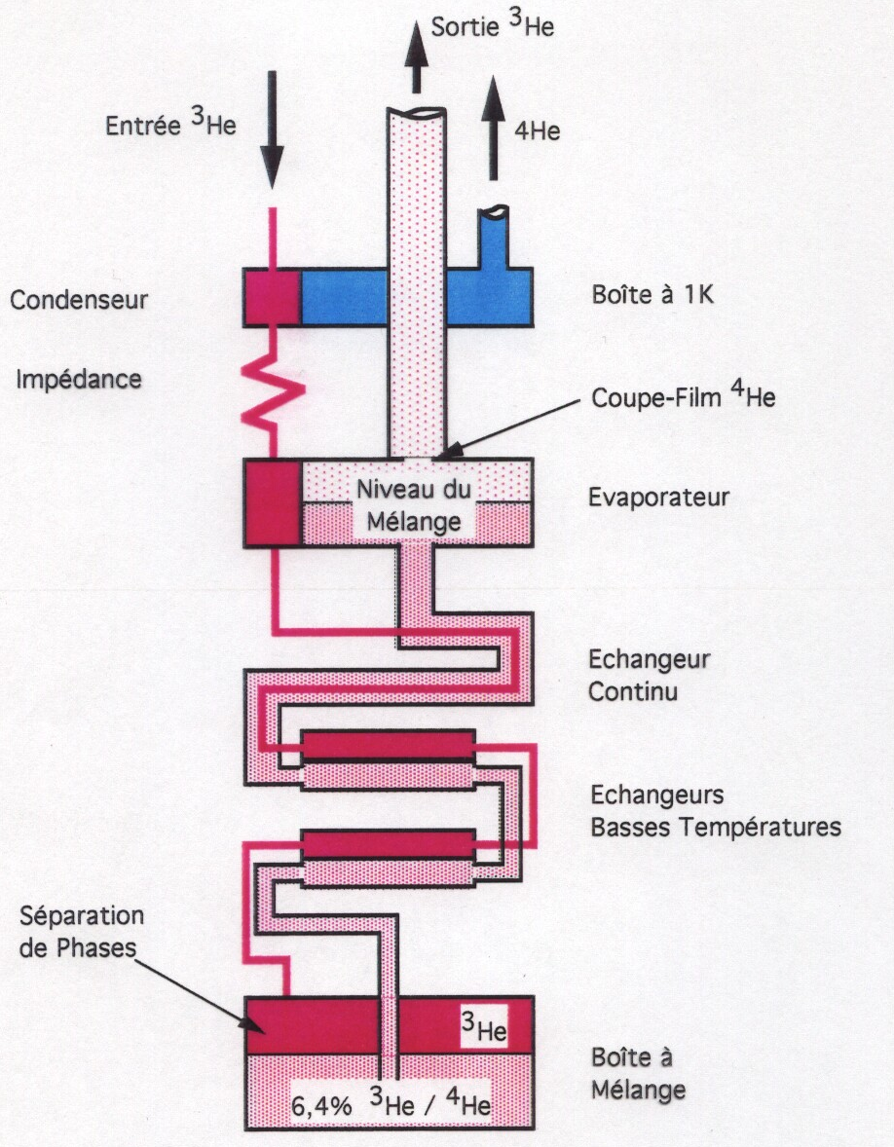
Schematic view of a DR

Slide 6
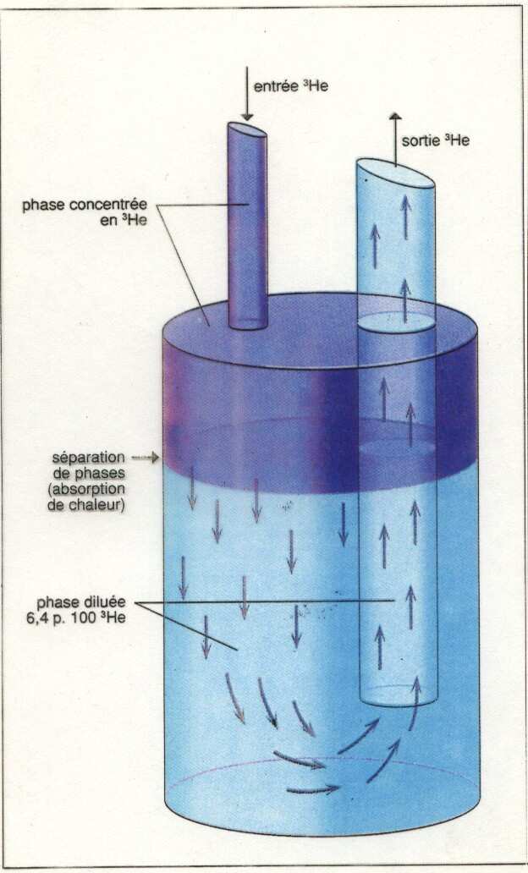
The mixing chamber

Slide 7
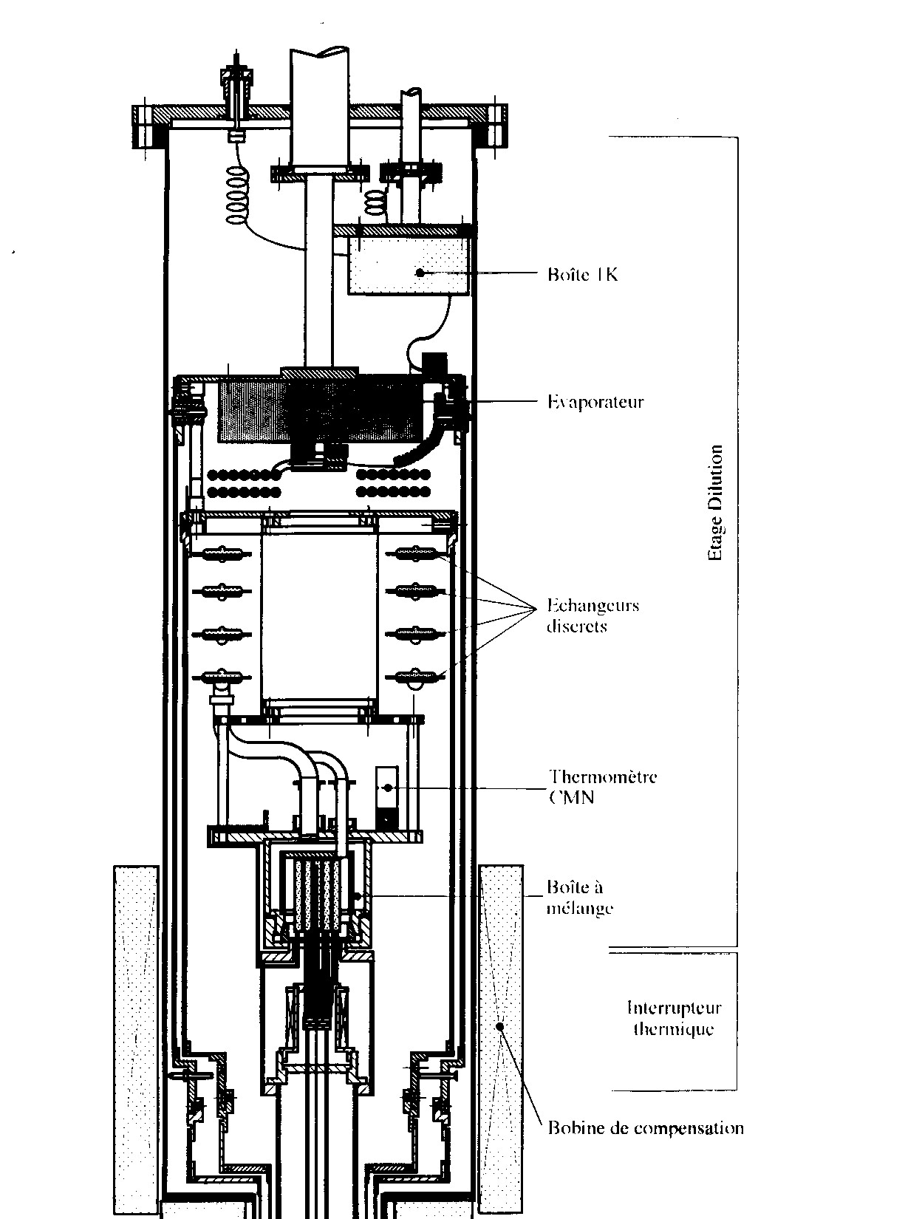
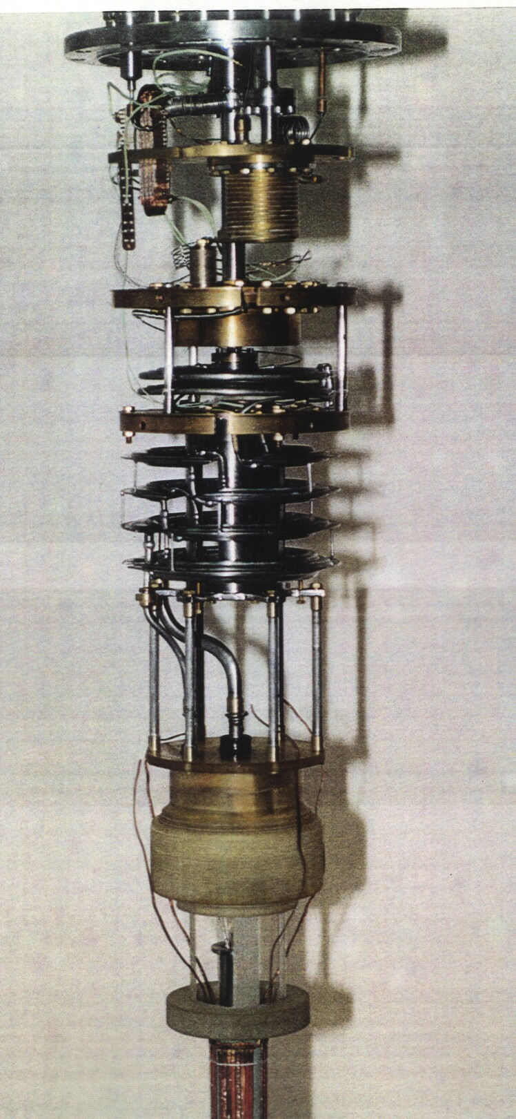
The 1K pot
Thermalizing 3He
… and other stuff!!
4He Flow rate
4He Volume stored
Filling capillaries
Cold valves
Filters
Level sensing?
Vibrations!

Slide 8
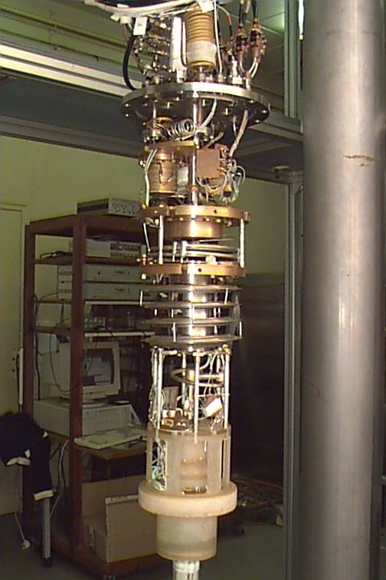
Condensing the ³He
Thermalizing in 4He bath
Thermalizing on 1K pot
Thermalizing on still
Thermalizing in continuous exchanger

Slide 9
No 1K pot?
Condensation pressure higher
Compressor needed (essentially during initial condensation)
Risk of leaks
More 3He needed (cost!)
But it is so nice to live without the 1K pot problems!!!

Slide 10
The mixing chamber
The heart of the dilution refrigerator
Large volume:
    easier determination of amount of mixture
    stability against pressure changes
Heat exchanger made out of sintered silver powder
Magnetic fields: plastic mixing chambers
Conical or flat plastic plugs for easy access

Slide 11
Heat exchangers & cold plate

Slide 12
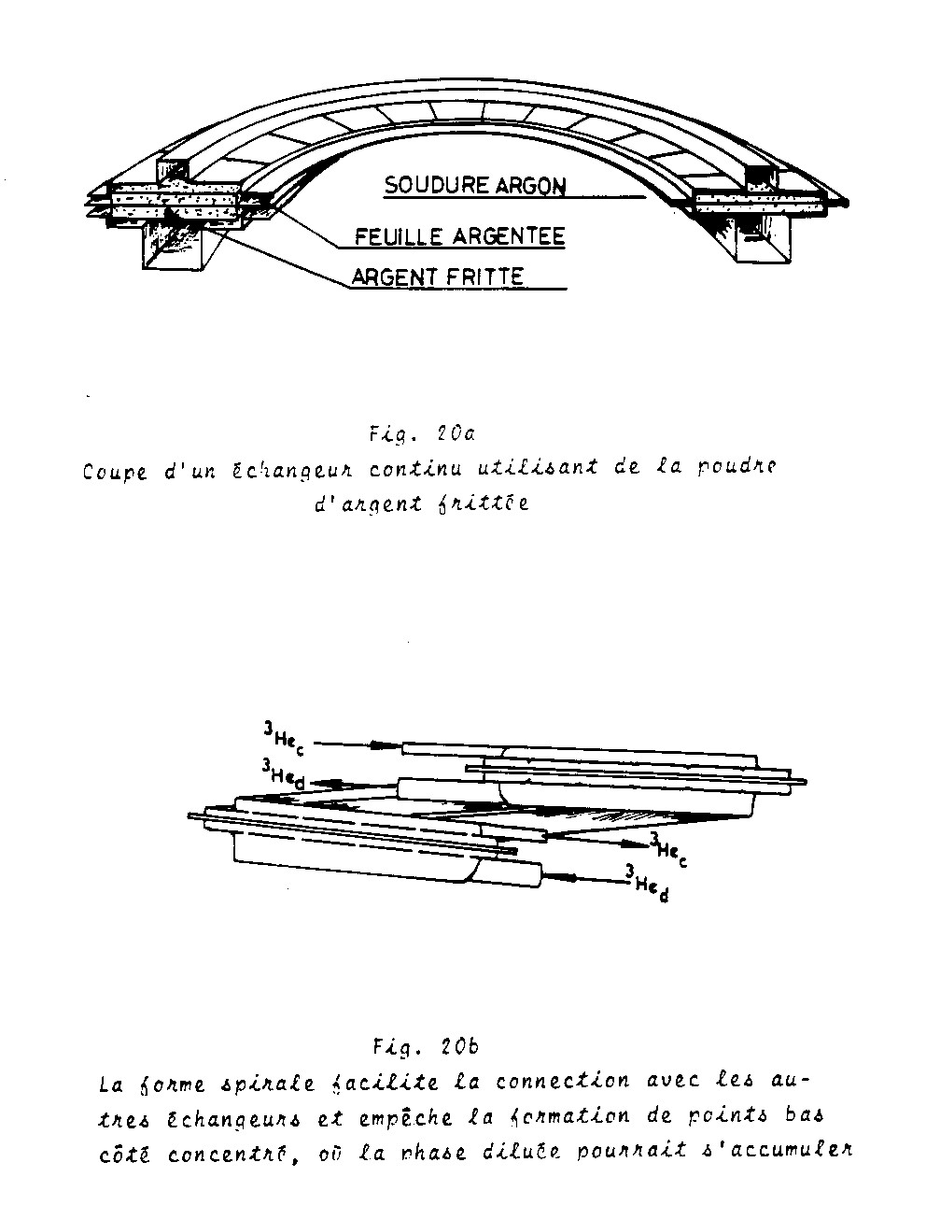
Sintered silver heat exchangers

Slide 13
The still
Large volume, large area
Do not fill, only a few mm!
Film burner and/or diaphragm

Slide 14
The complete drawing!

Slide 15
The real thing!

Slide 16
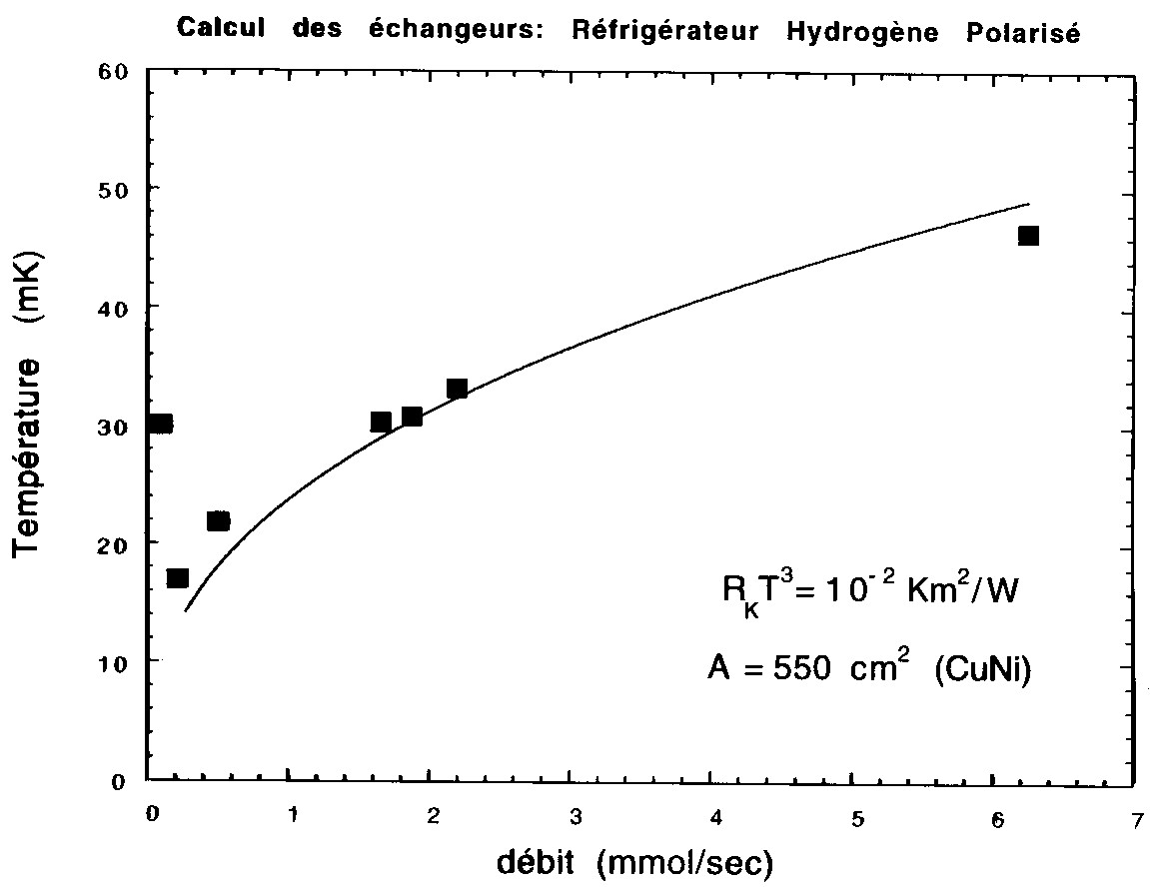
Cooling power of a DR as a function of the flow rate

Slide 17
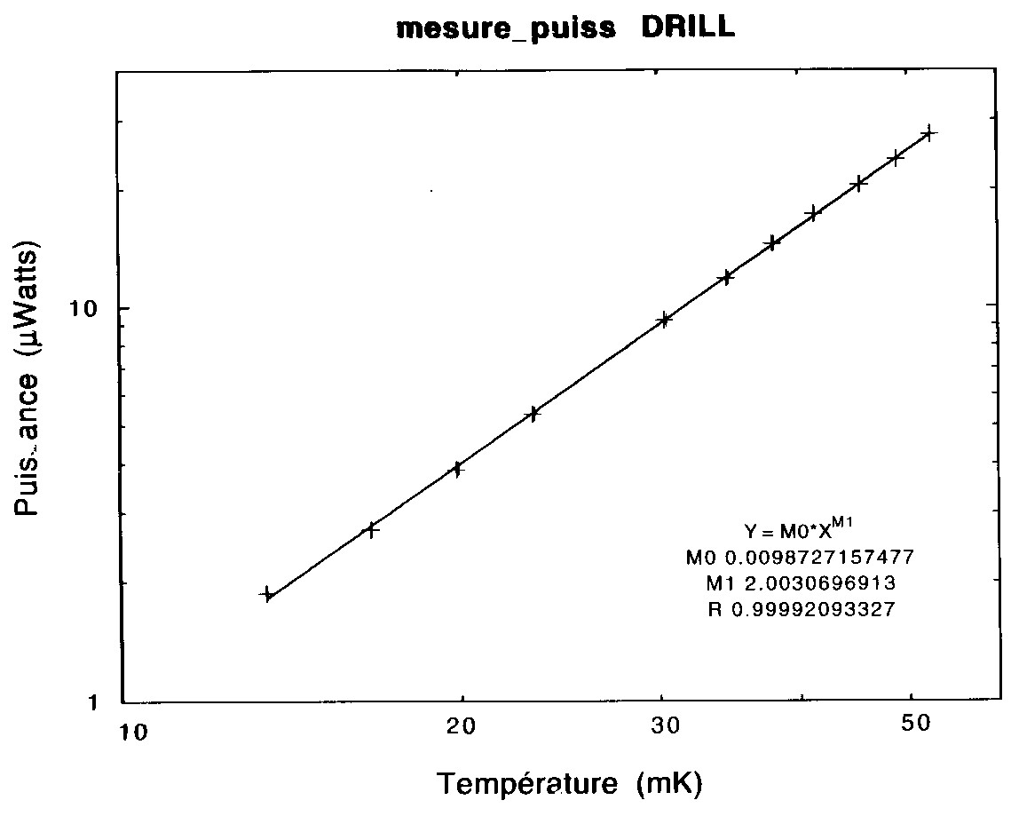
Cooling power as a function of temperature
(T_{min} of this DR = 5 mK)

Slide 18
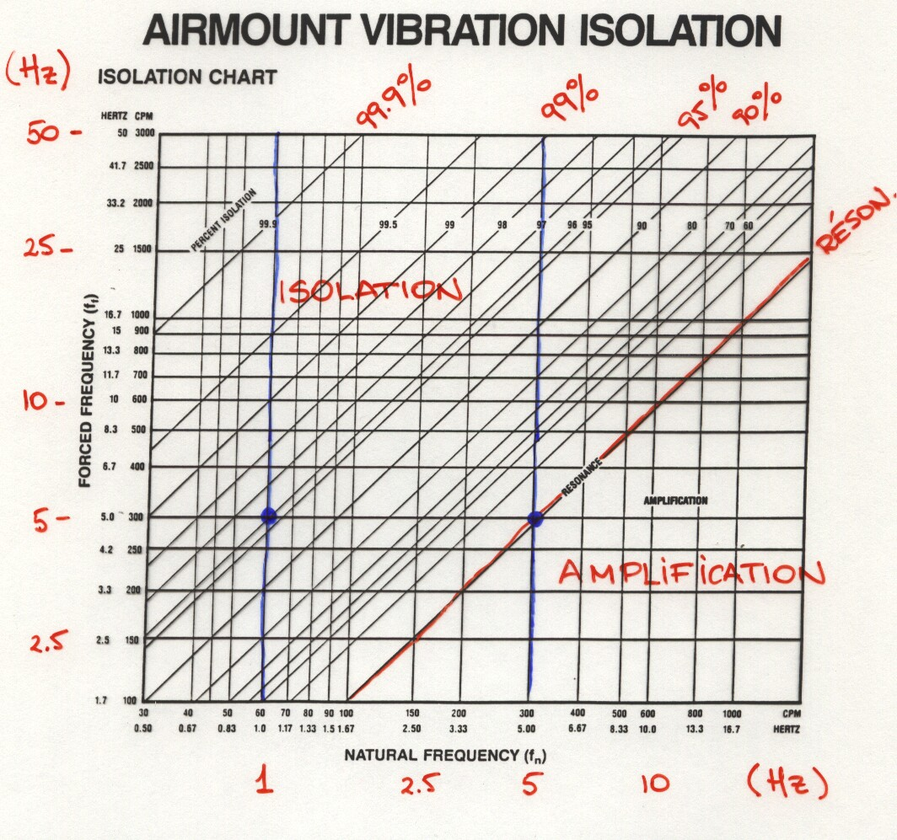
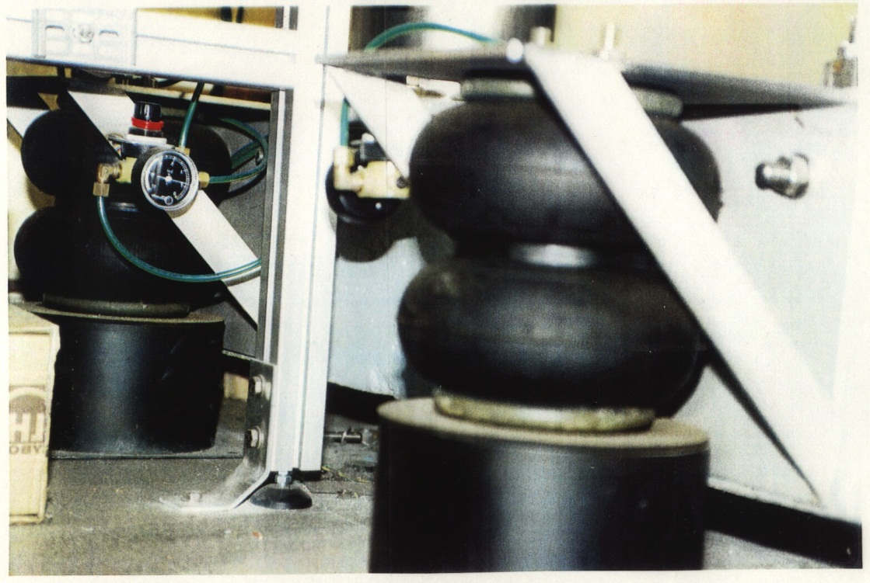
Vibration isolation

Slide 19
Well, you decided to have a DR…
(or you had no choice!)
There are many kinds of dilution refrigerators:
- Classical, Helium (and nitrogen?) bath: Ultralow temperatures, measurements with superconducting coils, special samples...). Several manufacturers: Air Liquide, Cryoconcept, Leiden Cryogenics, Oxford Instruments, etc.
- With partial cryogenic bath and shields (DRILL, Sionludi) (neutrons, X-rays, etc...) “Table cryostat” Air Liquide, Oxford Instruments,…
- Pulse-tube Dilution refrigerators: Air Liquide, Leiden Cryogenics, BlueFors Cryogenics, Oxford Instruments, Cryoconcept, Vericold,…
- "top loading" : fast measurements with small samples, Oxford Instruments,…
- Inserts (Neumeier, Garching), ILL
- Horizontal (Niinikovskii, CERN)
- ⁴He circulation (de Waele, Eindhoven; Schumacher, Grenoble)

Slide 20
Some choices…
Precooling stage:
- With 1K pot?
- Joule-Thompson stage?
Pumping: a rotary pump and…?
- diffusion pump?
  Roots?
  Turbo-molecular pump?
  Adsorption pump?

Slide 21
Design considerations
Obtaining low temperatures and high cooling power (dn/dt >100 µmoles/sec):
1) optimisation by a careful calculation:
- heat exchangers (sintered silver powder step exchangers).
- conduction and viscous heating in the low temperature parts.
- pressure drop in the pumping lines.
- condensation of the mixture
2) Optimisation of the mechanical parts:
- vibrations
- viscous heating
3) Empirical optimisation (know-how!):
- circulation of 4He
- interaction of the dilute 3He on the excitations of 4He
4) Optimisation of the reliability:
- simple design
- modularity
- foresee leak testing by elements
5) Training the operators!

Slide 22
Where do I put my DR now…???
Check-list:
  Space available: area, height…
  Door width (can the DR Dewar enter the room??)
  Do I need to make holes in the floor or ceiling?
  Dewar, pumping lines…
  Room for the helium and nitrogen storage dewars?
  Room for the pumps?
  Electrical power? Water? Compressed air?
  Helium recovery lines?
  Anti-vibration system?
  Shielded room?
Adapt the design to the needs.
Adapt the design to the constraints

Slide 23
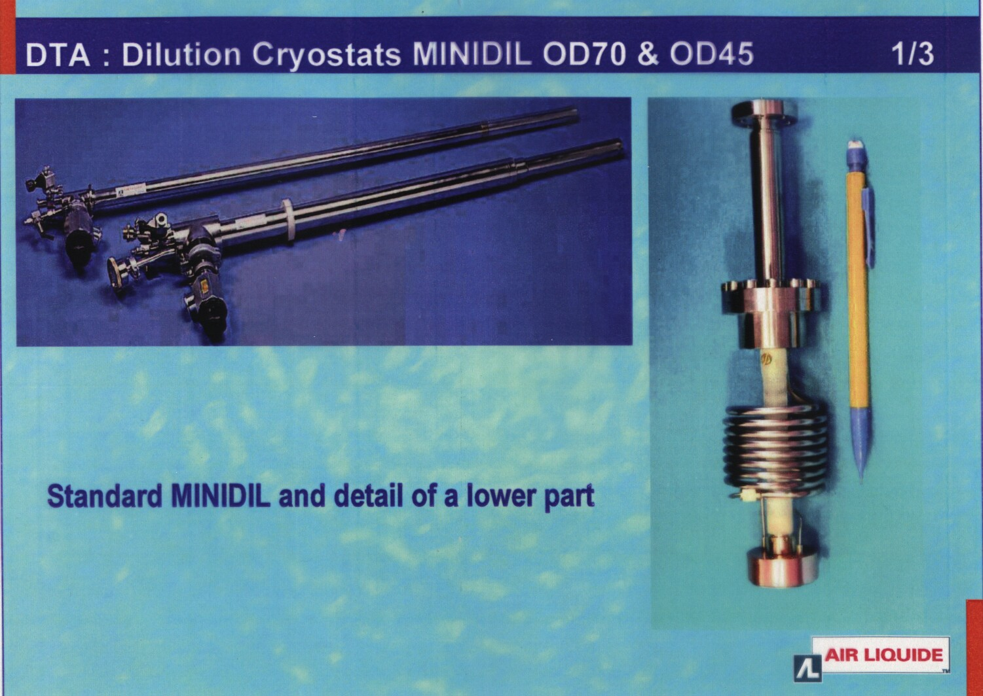

Slide 24
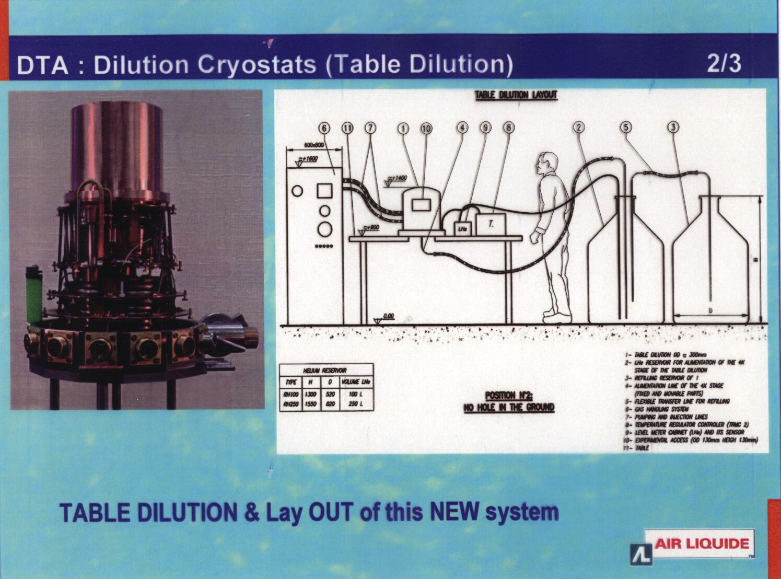

Slide 25
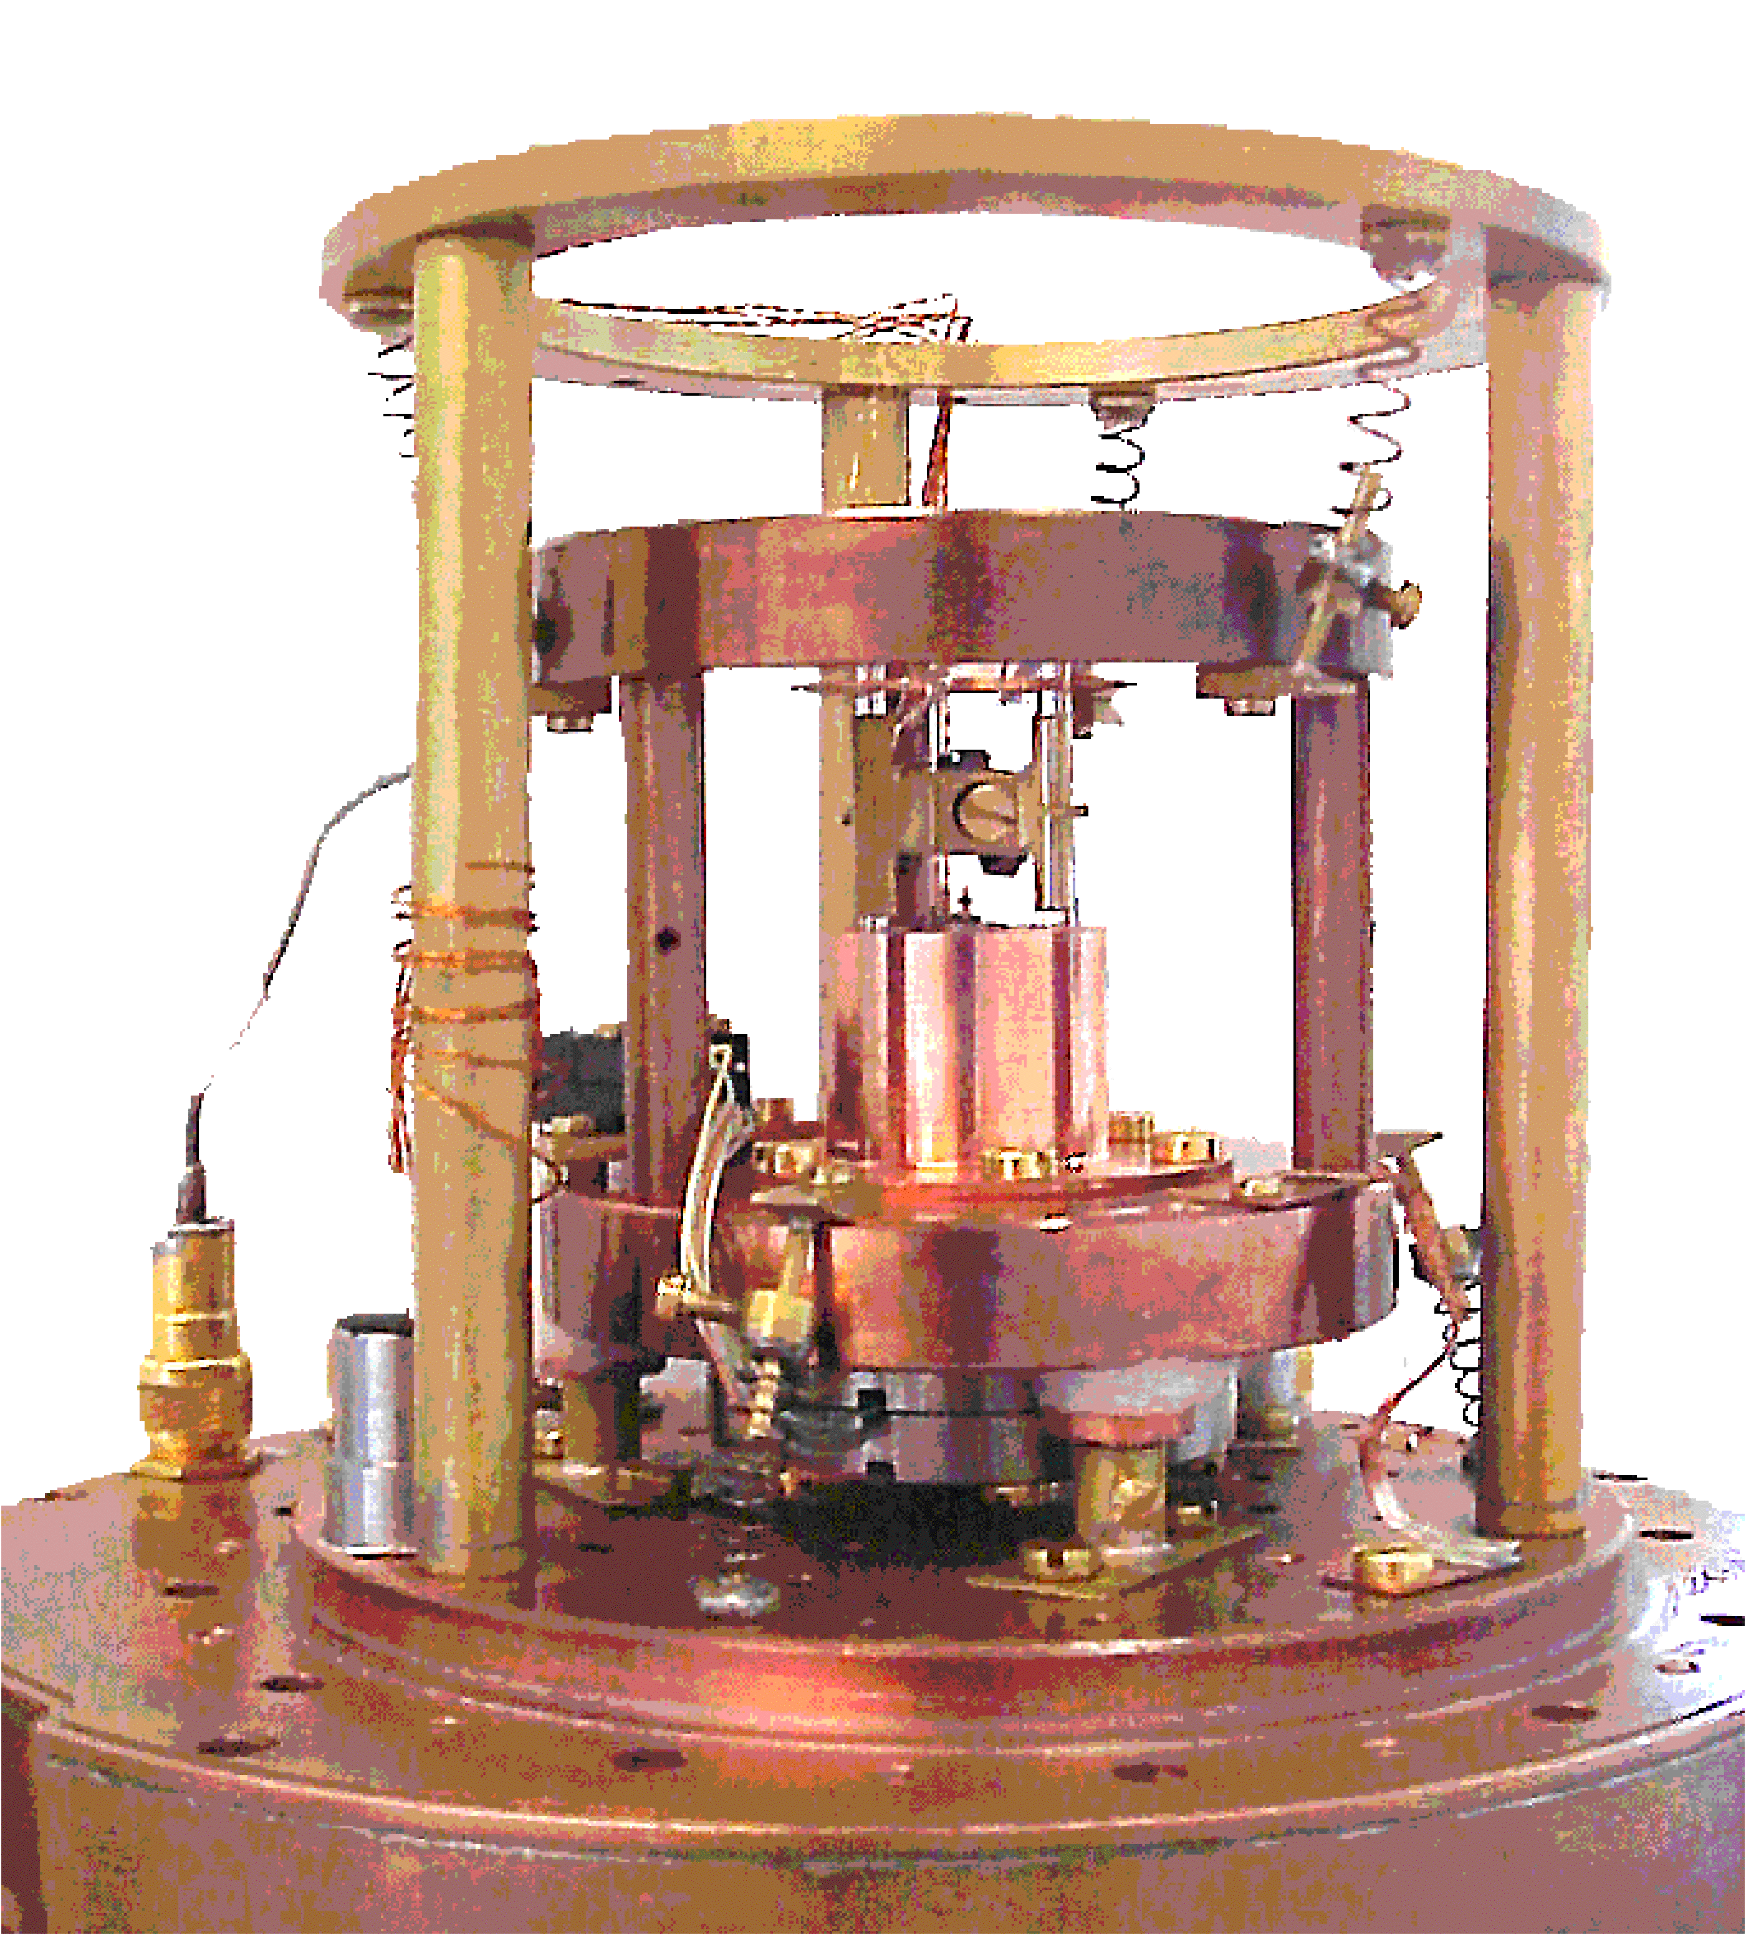
Table-top Dilution Refrigerator 50 mK
CNRS – Air Liquide
A. Benoit
STM, AFM, optical access…

Slide 26

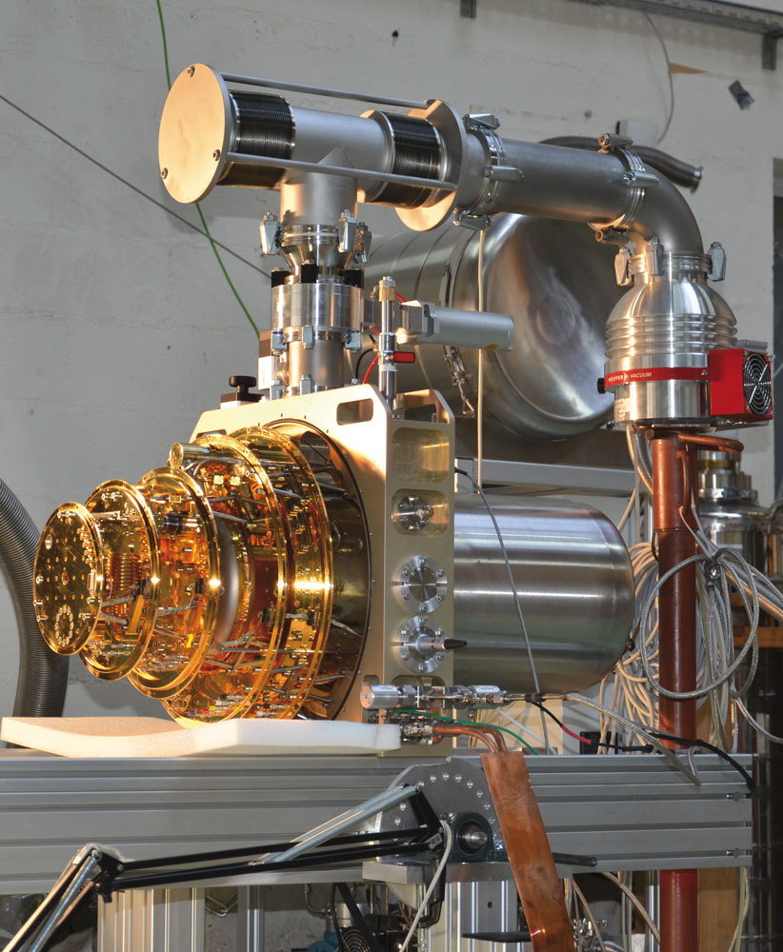

Base temperature < 30mK
Stability @ 30mK 0,1 mK
250µw @ 100mK
Less than 16 hours for 300K-30mK
Liquid helium hold time 48 hours
(up to 10 days with automatic refill)

Slide 27
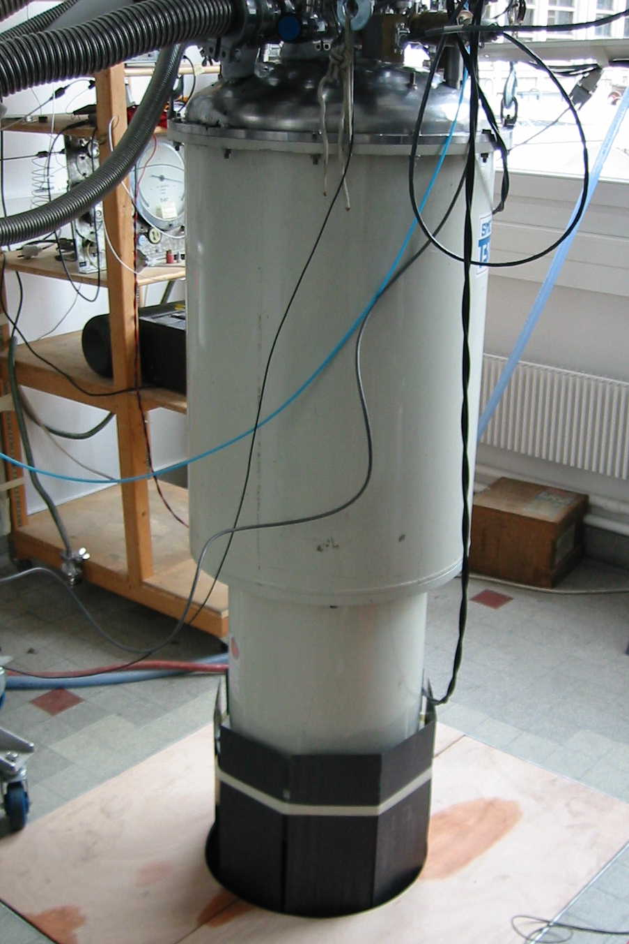
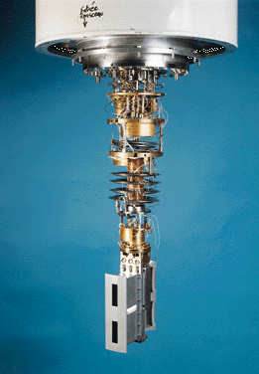
DRILL – 5 mK DR for neutron scattering

Slide 28
DN1: Dilution refrigerator
for ultra-low temperatures

Slide 29
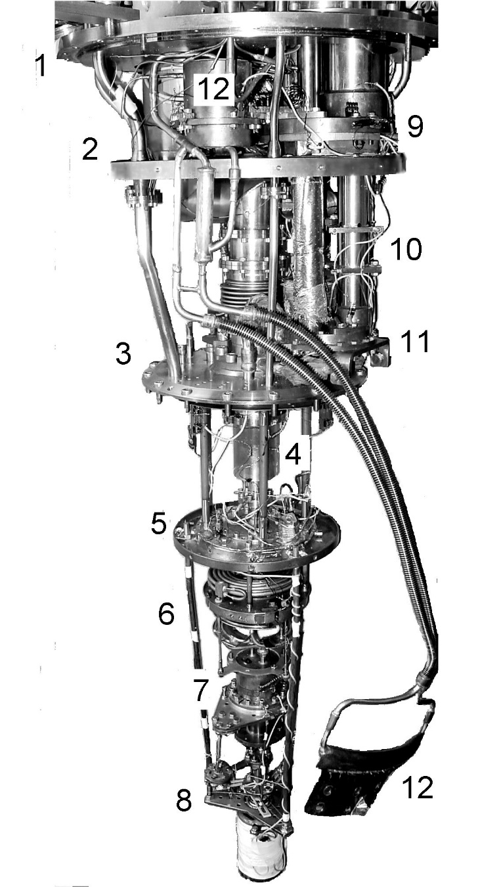
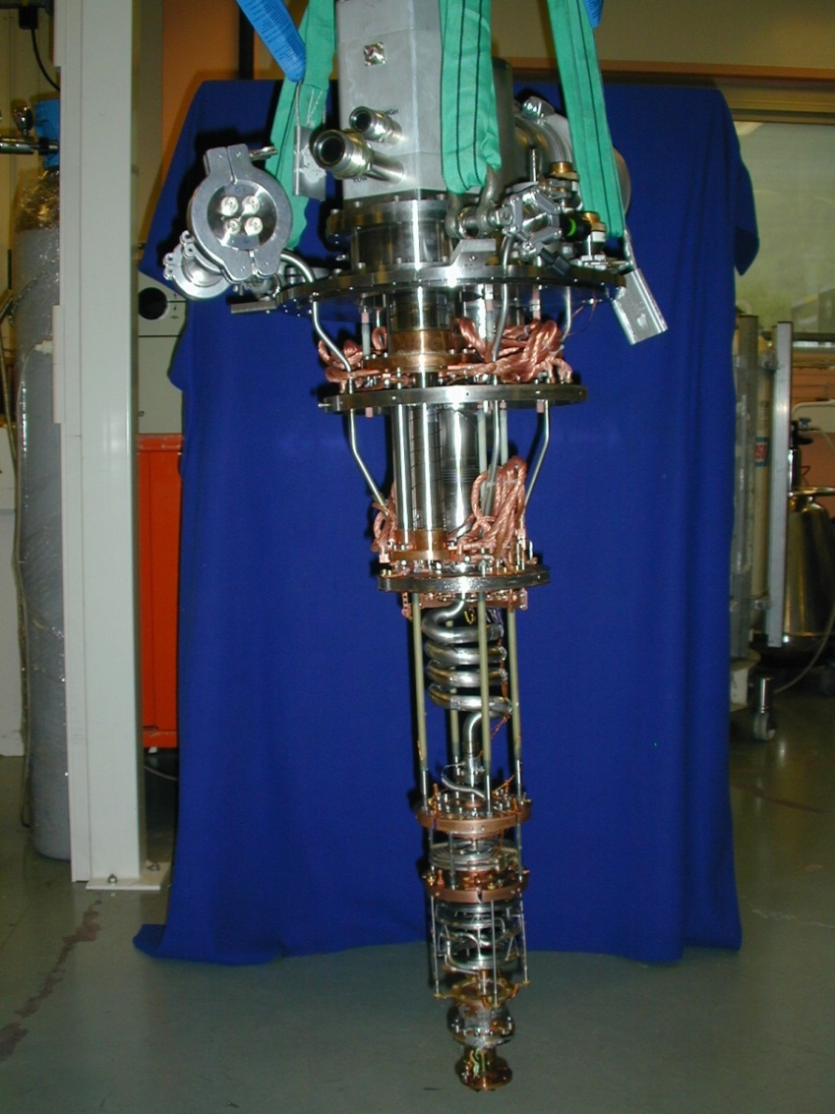
PT-DR1 (1999) and PT-DR2
(Commercial unit delivered 2003)
H. Godfrin, S. Triqueneaux (CNRS & Air Liquide)
Th. Prouvé, S. Triqueneaux, H. Godfrin

Slide 30
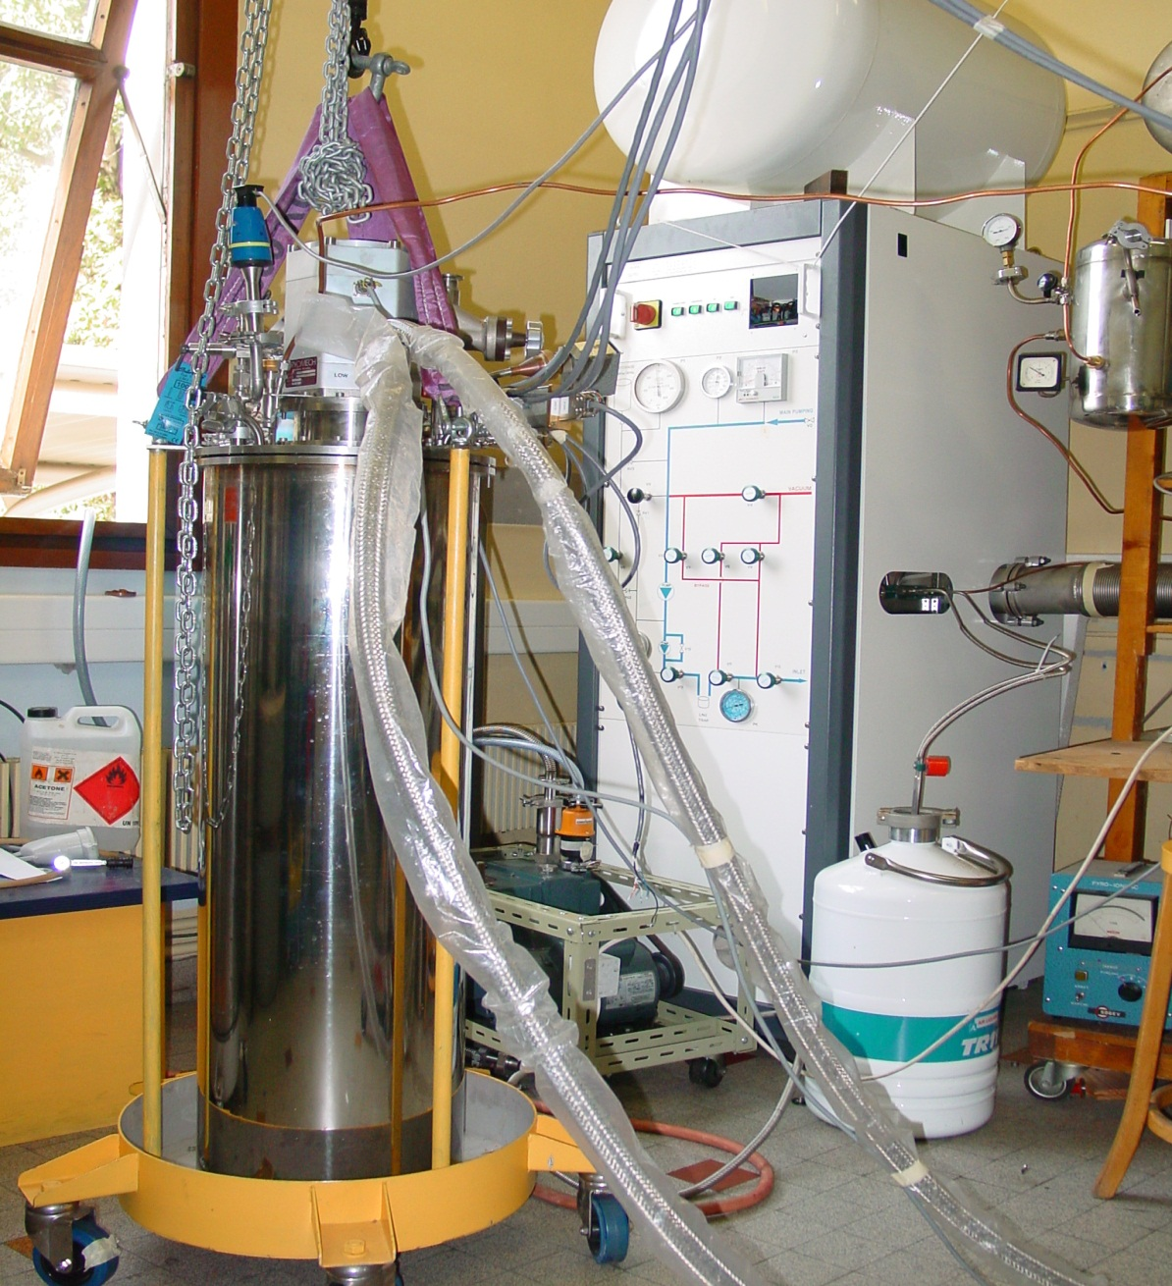
Pulse-Tube dilution refrigerator PT-DR2
(industrial collaboration with l’Air Liquide)

Slide 31
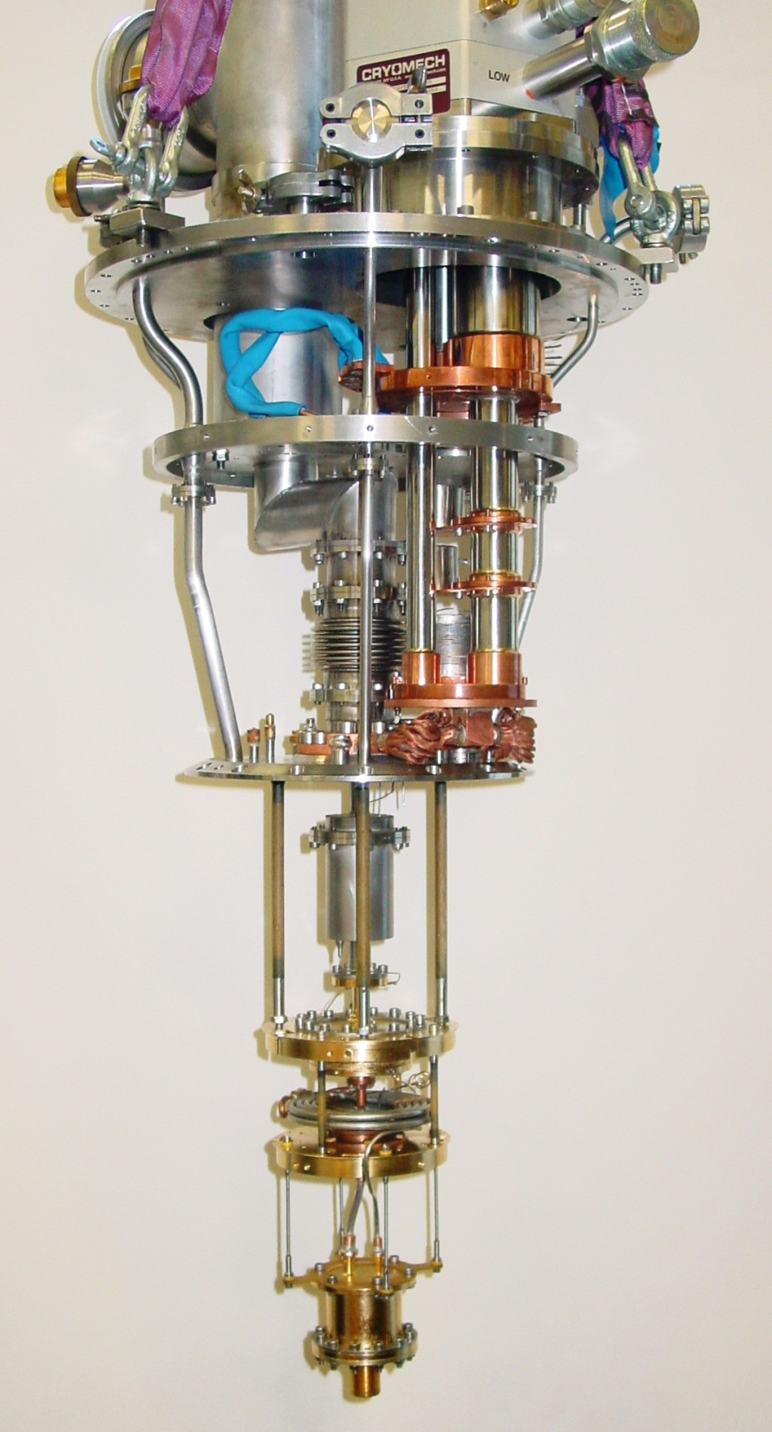
Commercial unit
PT-DR3
CNRS - Air Liquide

Slide 32
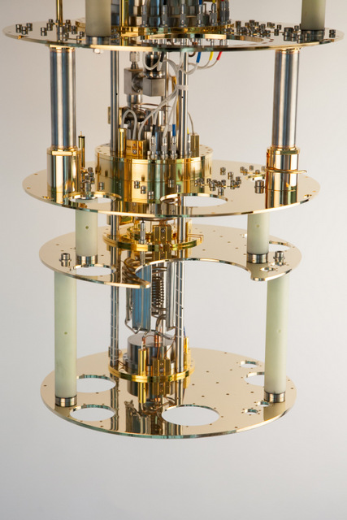

Base temperature < 10mK
400µw @ 100mK
Stability @ 20mK 0,1 mK
10 µw @ 20 mK
High temperature 30K

Slide 33

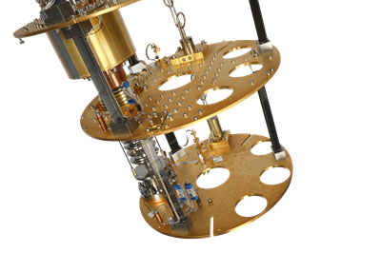
 | With DU7-500 dilution unit | With DU7-300 dilution unit
Base T: | 8 mK typical, < 10 mK guaranteed | 8 mK typical, < 10 mK guaranteed
At 100 mK: | 500 μW typical, 450 μW guaranteed | 300 μW typical, 250 μW guaranteed
At 20 mK: | 15 μW typical, 12 μW guaranteed | 10 μW typical, 8 μW guaranteed
³He requirement: | 18 litres STP | 11 litres STP

Slide 34
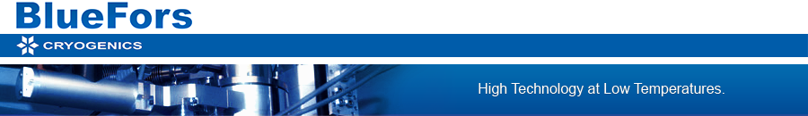
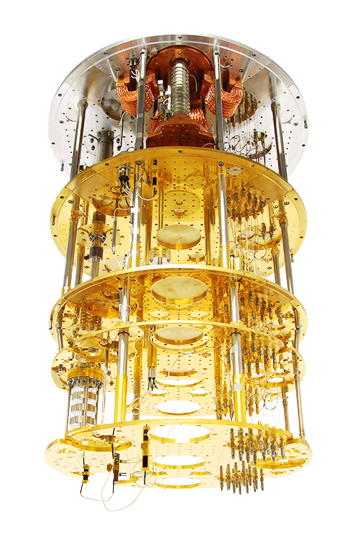
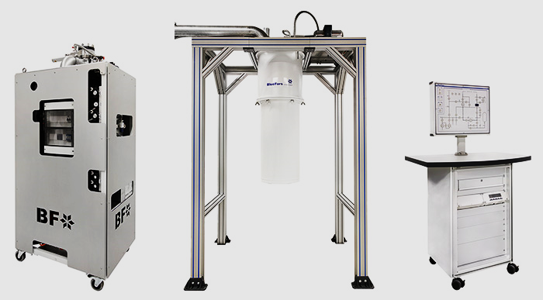

Slide 35
Playing with the mixture…
Calculate all the volumes of all circuits inside the RD, and also in pumps, traps, lines, etc…
Calculate the amount of 3He and 4He gas needed
Remember that the still has less than 1% concentration of 3He…
Mixing Chamber should be large for stability…
Start with minimum amount of mixture!
Best operation with small amount of mixture in the still, and small amount of concentrated phase in mixing chamber

Slide 36
Condensation of the mixture
Pre-cooling of cryostat at 4 K
Pump the exchange gas (pump or adsorption)
Check tanks pressure
Check LN2 (eventually LHe) traps
Circulate mixture through the traps.
Long condensation process (hours)
Condensation temperature must be low to avoid additional delays.
Start circulation. With tricky cryostats, start with high flow rates (4He low points)

Slide 37
Operating the RD…
Flow rate is determined by the still power, not by the pumps!
This is NOT true for PT-DRs (no 1K pot, large heat of condensation)
Choose adequate flow rate (high power, or T_{min} ?
With high circulation rates, ⁴He poisoning of the RD.
High temperature ( T> 1 K) operation: remove mixture, use only the mixture of the pump.

Slide 38
Warm-up
Removing the mixture takes a long time
Heating the MC and Still: not very efficient!
Exchange gas? Caution! Unstable, keep P < 10⁻⁴ mBar
Close tanks, put rest of the mixture in the pump, close the pump.
Traps: throw away (pumping) what was not pumped when the nitrogen trap was cold.
Do not allow water condensation on RD…

Slide 39
Troubleshooting
1 K pot hot, pressure is low. Filling capillary blocked. Remove LHe so that the bath level is below the intake, keep 4He pressure in Pot above bath pressure. Heater on capillary…
High inlet pressure. Air? Hydrogen? Water?
Low still pressure. Still empty? Check T vs. P!
No cooling power. Interface level in MC? Heat leak to MC? Apply heat and check cooling power at higher temperatures. ³He/⁴He ratio OK?
Heating spikes, oscillations. Superfluid leak to Vacuum can?

Slide 40
Good luck!
Building a dilution refrigerator is NOT easy
Repairing a dilution refrigerator is even worse.
We told you….!

Slide 41
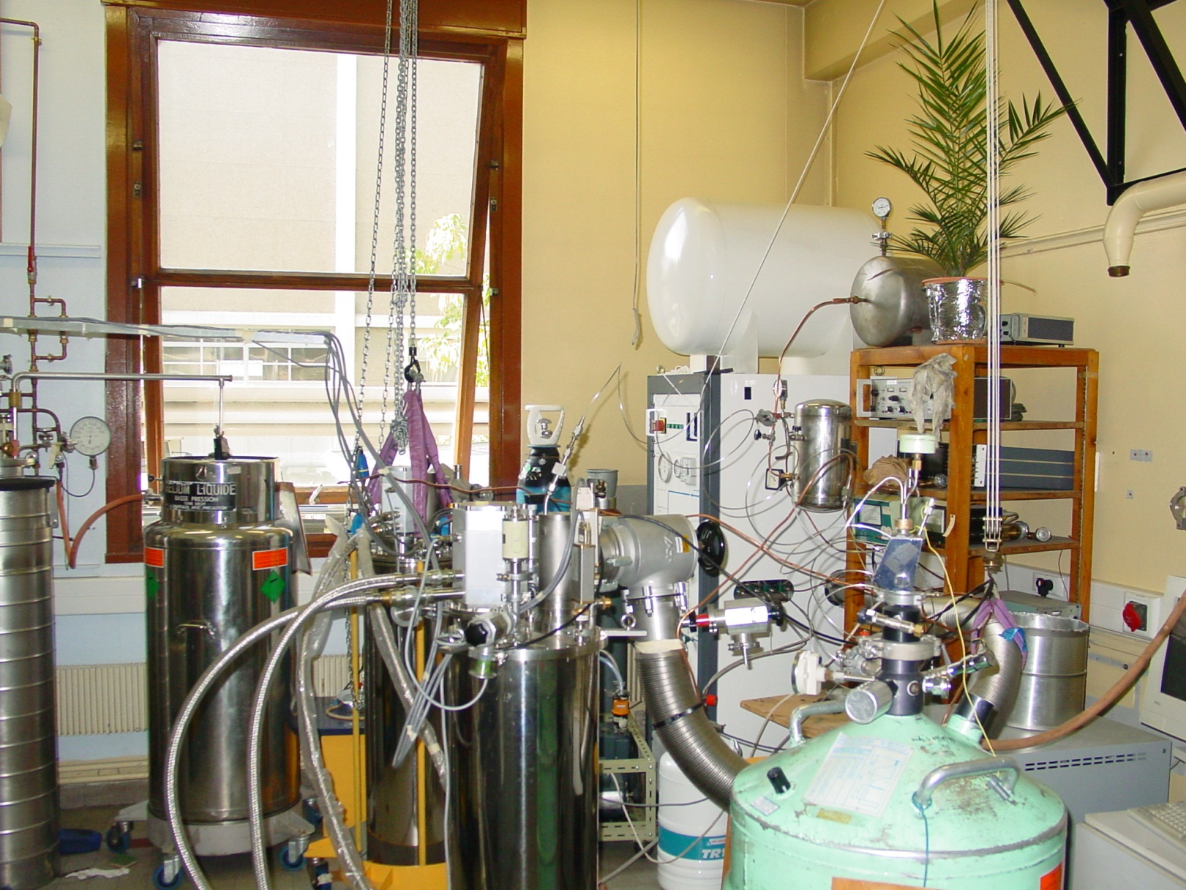
Pulse-tube ³He/⁴He Dilution refrigerators

