Slide 1
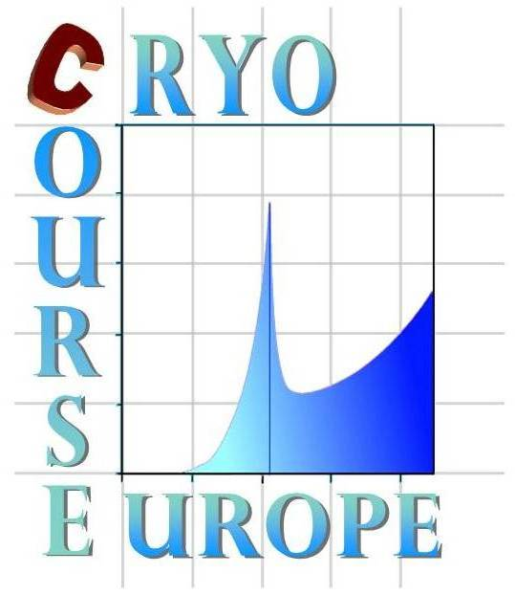



Cryocourse 2016
School and Workshop in Cryogenics and Quantum Engineering
26th September - 3rd October 2016
Aalto University, Espoo, Finland
Introduction to Dilution Refrigerators
Part I-Thermodynamics
Henri GODFRIN
CNRS/IN/MCBT – Grenoble

Slide 2
This part of the course is based on:
Basic operation of cryocoolers and related thermal machines
A.T.A.M. de Waele
J. of Low Temp. Physics, Vol.164, pp.179-236 (2011) (open access)
Introduction to dilution refrigeration
A.T.A.M. de Waele
Lectures given at Cryocourse 2013 and former ones
Dilution refrigerators
H. Godfrin
Lectures given at Cryocourse 2013 and former ones
Experimental Principles and Methods Below 1 K
Lounasmaa, O.V.
Academic Press, London, p. 316 (1974).
Matter and Methods at Low Temperatures
Pobell, Frank
Springer-Verlag, Berlin, p. 461 (2007).
Wikipedia: https://en.wikipedia.org/wiki/Dilution_refrigerator

Slide 3
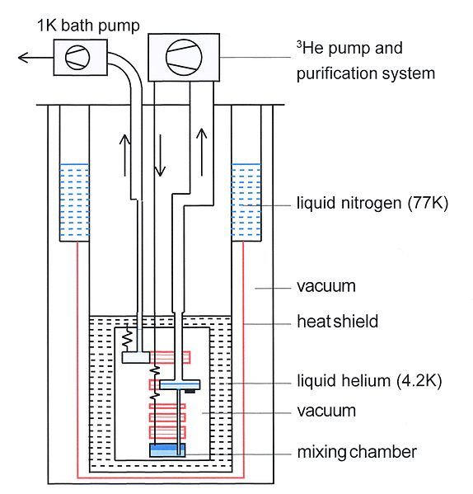
Outline
Introduction
Schematic diagram
Thermodynamics of dilution refrigeration
Thermal properties of pure 3He
Properties of 3He-4He mixtures
The 1 K bath
Why a still heater
The mixing chamber
Osmotic enthalpy
Limiting temperature of dilution refrigerators

Slide 4
History
The dilution refrigerator principle was suggested by Heinz London in 1952
H. London, G.R. Clarke, and E. Mendoza proposed a prototype of continuous refrigerator in 1962
It was realized in 1964 in the Kamerlingh Onnes Laboratorium at Leiden University
Das, P.; Ouboter, R. B.; Taconis, K. W. (1965). "A Realization of a London-Clarke-Mendoza Type Refrigerator". Low Temperature Physics LT9. p. 1253. (Tmin~220mK)
B.S. Neganov and co-workers in Dubna and H.E. Hall and co-workers in Manchester went below
100 mK (1966). Dubna rapidly reached 25 mK.
The principles and methods of dilution refrigeration have been substantially developed by J. Wheatley et al. at La Jolla.
Modern « wet » refrigerators are based on the Grenoble design by Frossati and coworkers.
The development of sintered silver heat exchangers Tmin led to Tmin~2 mK.
« Dry » refrigerators were developed
by K. Uhlig et al. on GM coolers (1993),
and on Pulse-tube coolers by K. Uhlig et al. (2002) and H. Godfrin (1999 to 2003, date of first commercial unit, delivered by l’ Air Liquide)
Lancaster has the present record of low temperatures, 1.75 mK

Slide 5
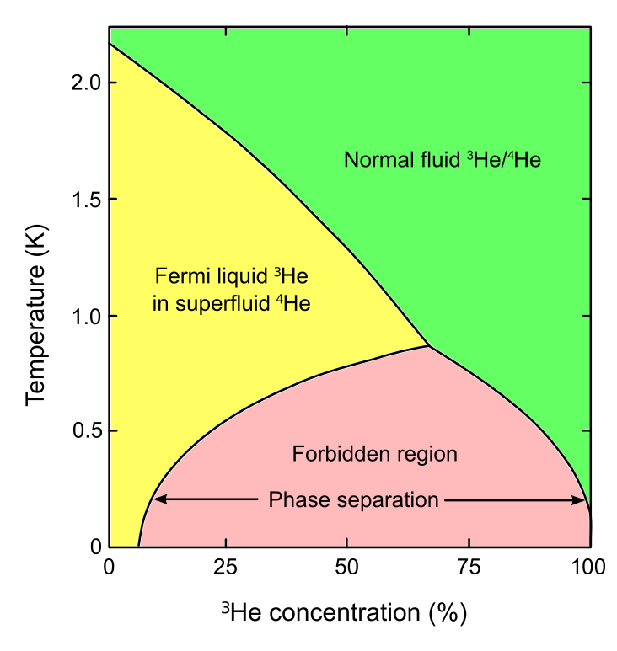
Phase diagram of helium mixtures
By Mets501 - Own work, CC BY-SA 3.0, https://commons.wikimedia.org/w/index.php?curid=25250292

Slide 6
Phase separation upon cooling

Slide 7
Schematic diagram of a standard (“wet”) dilution refrigerator.
https://en.wikipedia.org/wiki/Dilution_refrigerator

Slide 8
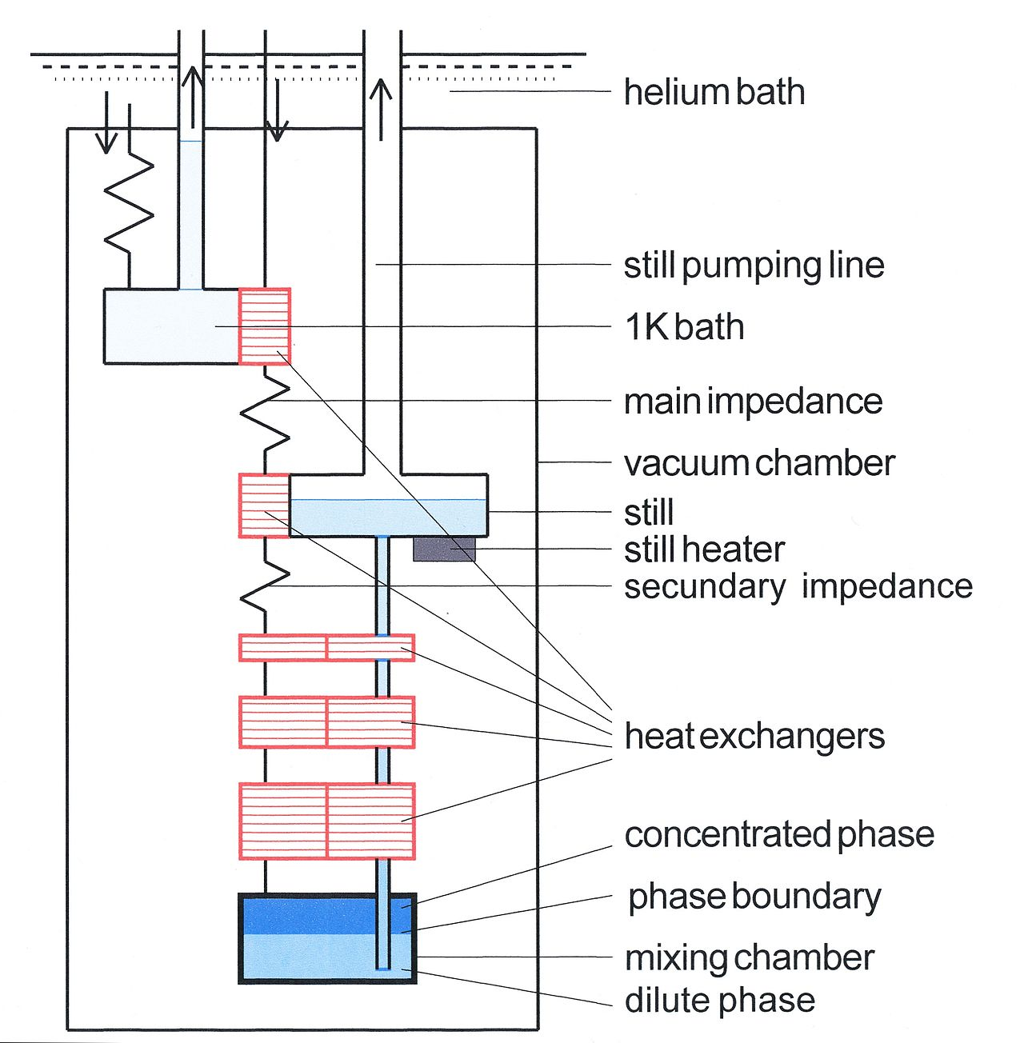
Low temperature part
https://en.wikipedia.org/wiki/Dilution_refrigerator

Slide 9
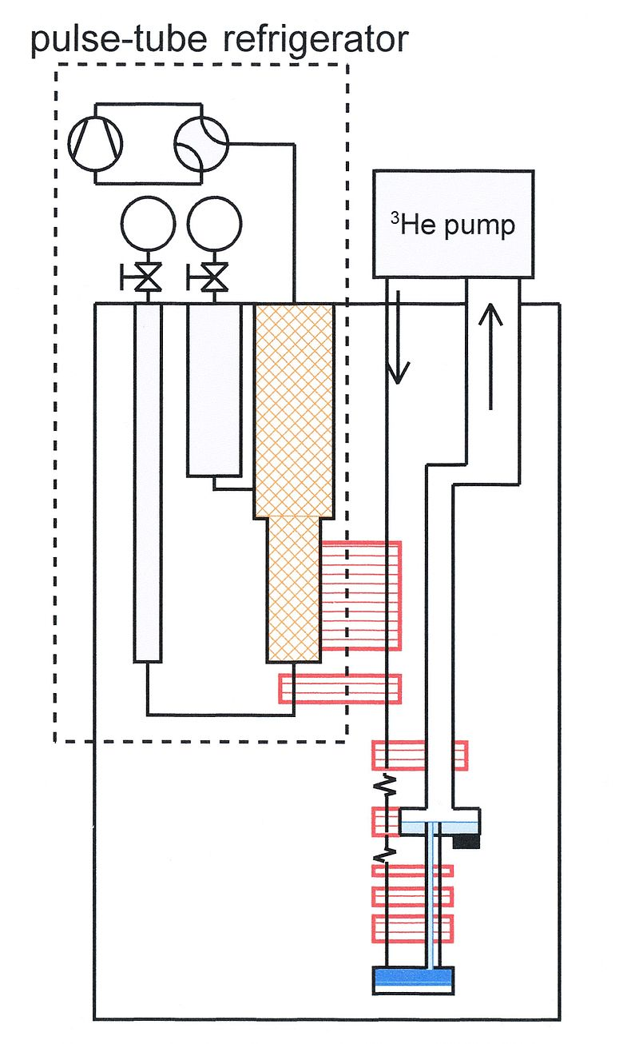
https://en.wikipedia.org/wiki/Dilution_refrigerator

Slide 10
Continuously Operating ⁴He Evaporation Refrigerator
L. E. DeLong, O. G. Symko and J. C. Wheatley, Rev. Sci. Inst. 42, 147 (1971)

Slide 11
Enthalpy diagram of ⁴He

Slide 12
Enthalpy diagram of ³He
Incoming ³He at P=0.5 bar and 4.2 K has a enthalpy of 99 J/mol
³He leaves the still at 0.7 K and P~0. It’s enthalpy is 35 J/mol.
The deficit is huge: 64 J/mol
Solutions: 1K pot or condensation at high pressure

Slide 13
Global enthalpy balance of DR
(only pure ³He flows in and out the sub-system)
Without 1K pot: negative balance,
External cooling needed.
With a 1K pot at 1.2 K: positive balance,
external heating (usually at the still…)
needed.
The cooling power provided by the 1 K pot to change the ³He from gas at 0.5 bar and 4.2 K to liquid at 0.5 bar and 1.2 K, is

Slide 14
Condensing the ³He at ~3bars
At 4.2 K the minimum enthalpy (vs. Pressure) is Hm ≈ 42 J/mol near 3 bars,
just above the enthalpy of the vapor at 0.7 K (35 J/mol).
> steady state is possible using a heat exchanger to precool the incoming 3He !!!
J. Kraus, Cryogenics 17, 173 (1977)
A.T.A.M. de Waele, A.B. Reekers, H.M. Gijsman, Cryogenics 17, 175 (1977)

Slide 15
Dilute side

Slide 16
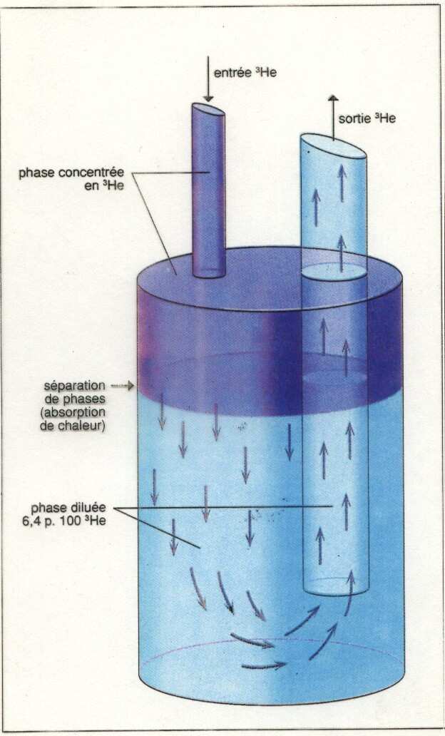
The Mixing Chamber: cooling is due to expansion

Slide 17
Osmotic enthalpy

Slide 19
Osmotic enthalpy of ³He mixtures
- Lines of constant osmotic pressure
(solid lines, values in Pa)
- Lines of constant osmotic enthalpy H3
(dotted lines values in J/mol);
and the saturation concentration of the
dilute phase xs.
The scale on the right gives the temperature in K.

Slide 20
Cooling power at the MC

Slide 21
Limiting temperature of DR

